Slide 1
Exploring uncertainty in the water resources estimation chain in southern Africa.
IGCP565
E. Kapangaziwiri
J. Mwenge Kahinda
Birchwood Hotel, Johannesburg
30th October 2012

Slide 2
Background
Many water resources decisions are based on outputs from models of a complex real world.
No matter how good our models are, the outputs will always be uncertain:
Even when the models are conditioned by observed stream flow data (i.e. calibrated) they include the uncertainties in these data.
General acknowledgement of uncertainty though not explored nor quantified
Therefore need to explicitly deal with uncertainty in the estimation process

Slide 3
Sources of uncertainty
The structure of the model & its ability to represent the real world.
The parameters of the model for a specific catchment:
  Notably when the catchment is ungauged.
The input climate data (rainfall and evaporation demand).
The model assessment data:
  Primarily stream flow data.
  But other data are being used more frequently.

Slide 4
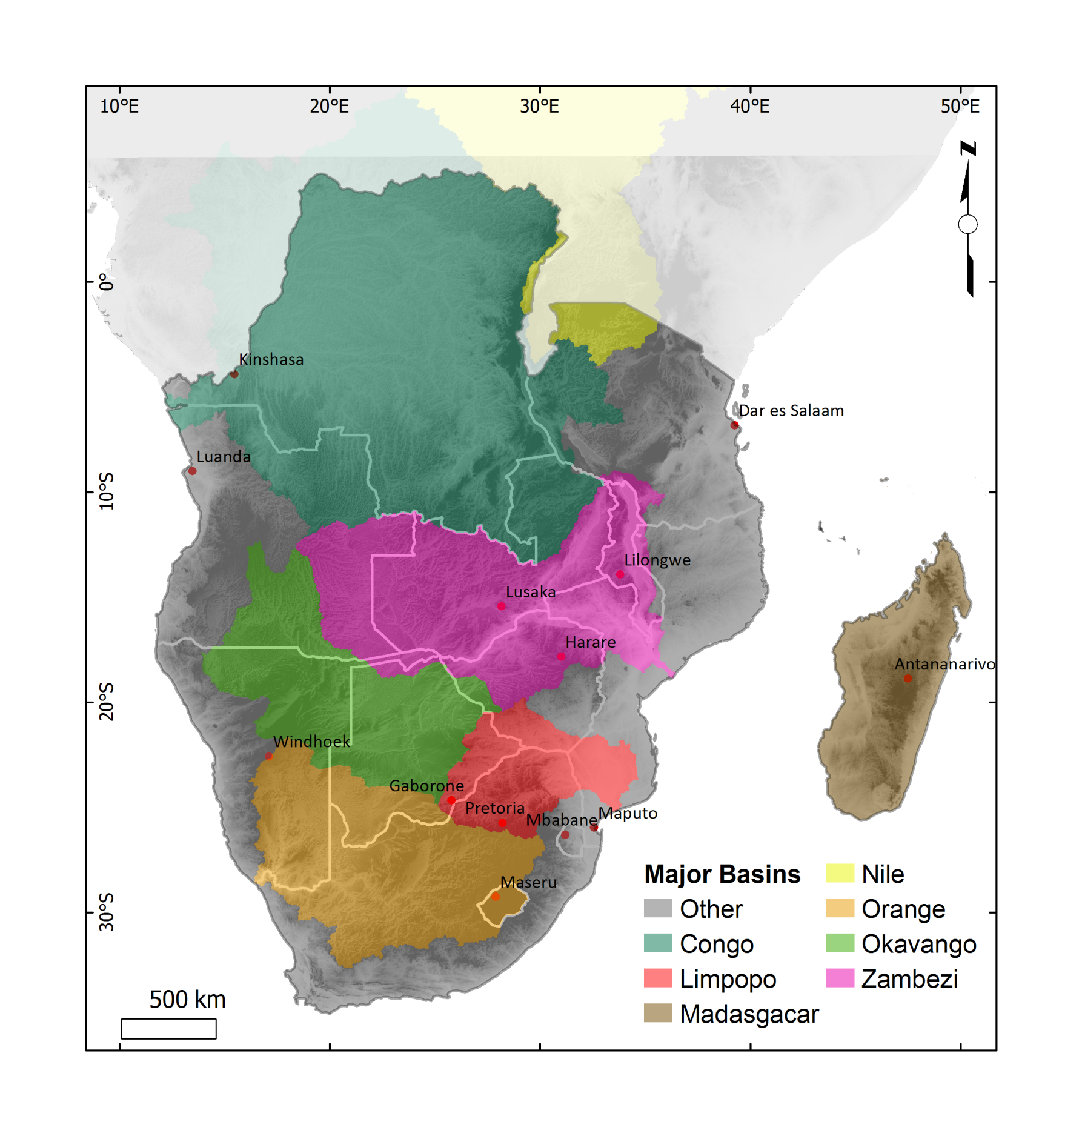
SADC Region – shared basins
Shared river basins for all the countries.
SADC Protocol on Shared Watercourses
SADC Water Policy; “ Member states shall adopt common or compatible procedures and methodologies for carrying out regular water resources assessment at regional, shared watercourses and national levels”, SADC (2006).

Slide 5
Uncertainty Framework for model application
Prior parameter distributions
Regional or observed constraints on indices of hydrological response
Decision making based on yield probability curves including all sources of uncertainty
Parameter sampling scheme (with options to include sensitivity analysis and optimisation)
System yield model
(including stochastic flow generation)
Hydrological
Model
Ensembles of flow predictions
Accepted hydrologically behavioural solutions
Stochastic rainfall model including climate change impacts

Slide 6
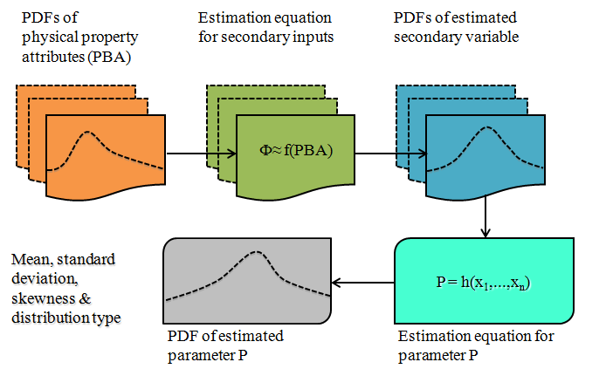
Estimation of the prior parameters
Parameters values estimated directly using basin physical characteristics

Slide 7
Constraints of hydrologic signatures
Index of the time series of a basin’s response characteristics and reflects the basin’s functional behaviour (e.g. runoff coefficient)
Used to constrain and condition continuous flow simulations
Three such constraints used
  Runoff ratio
  Gradient of the flow duration curve
  Groundwater recharge
Developed using existing data
Application strategy → compare generated model output ensembles against the constraints

Slide 8
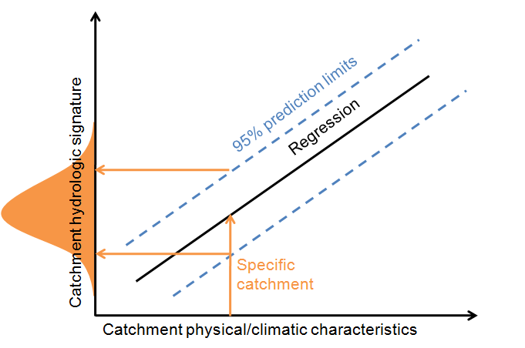
Constraints of hydrologic signatures

Slide 9
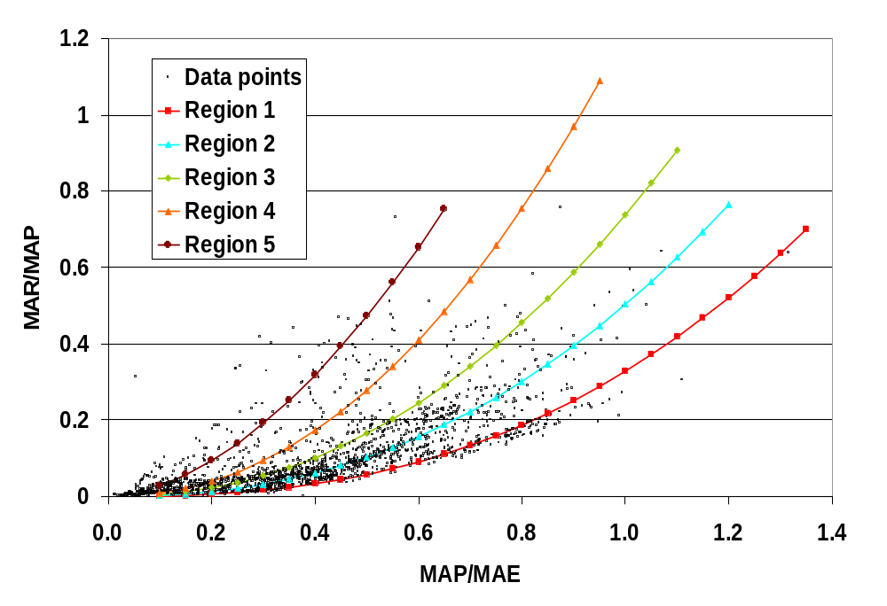
Runoff ratio constraint
A measure of water balance (MAR/MAP)
based on the concepts of Budyko
  regional relationships developed using data from previous studies and naturalised observed flow
  Resulted in 5 regions
  equation is of the form
  ln(Q/P) = A * ln(P/PE) + B
  constraint limits defined by +/- 95% prediction limits around the regional estimation equations
Predictors – MAP & MAE
 | Regions
 | 1 | 2 | 3 | 4 | 5
Based on simulated data
Slope (A) | 2.527 | 2.293 | 2.168 | 2.126 | 1.770
Intercept (B) | -1.113 | -0.687 | -0.304 | 0.194 | 0.478
R² | 0.927 | 0.968 | 0.984 | 0.990 | 0.866
Based on observed flow data
Slope (A) | 2.322 | 2.154 | 2.171 | 2.406 | 1.351
Intercept (B) | -1.079 | -0.741 | -0.338 | 0.475 | 0.173
R² | 0.932 | 0.905 | 0.890 | 0.917 | 0.820

Slide 10
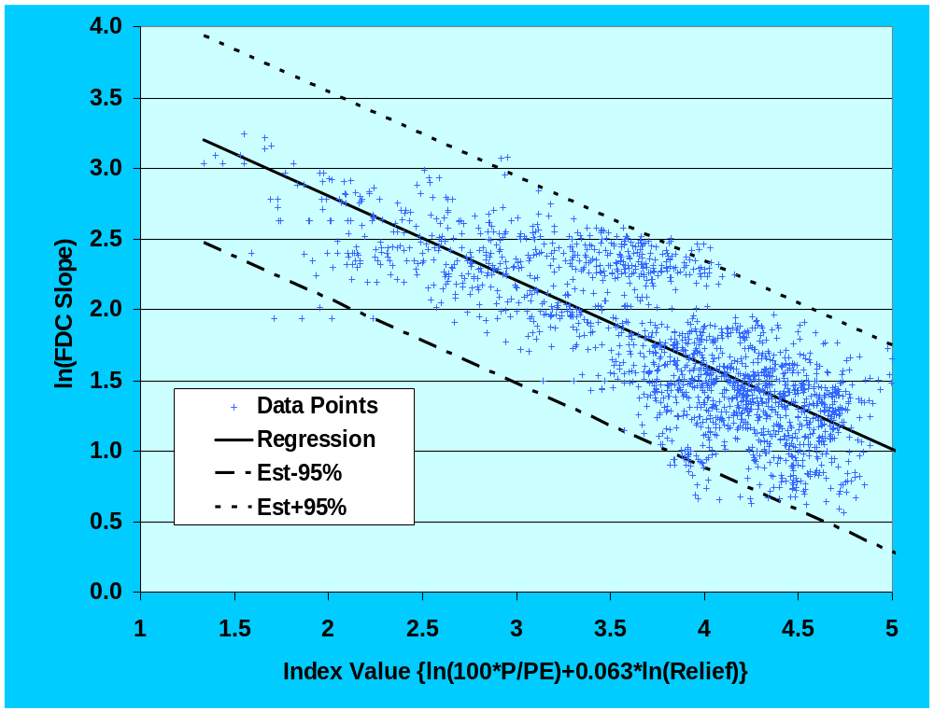
gradient of the flow duration curve (fdc) constraint
A measure of flow variability and basin response
Based on the 10th and 90th percentiles of the monthly flow duration curves
Could not be regionalised
Predictors → indices of aridity basin slope
Constraint boundaries defined by +/-95% prediction limits about the regression equation

Slide 11
ground water recharge constraint
A measure of base-flow contribution to channel flow
Based on available national GRAII database
Gives 3 values of recharge estimates per quaternary basin
Constraint limits are based on the available minimum and maximum basin-wide values

Slide 12
Example applications
Climatic and physical characteristics of test basins
A
Sub-basin | C12D | X31A | J33D | H10C | V70D
Area (km²) | 898 | 174 | 688 | 657 | 198
MAP (mm) | 661 | 1243 | 321 | 622 | 811
MAE (mm) | 1580 | 1400 | 2036 | 1650 | 1400
MAR (mm) | 59 | 452 | 20 | 164 | 143
MAR (%MAP) | 8.9 | 36.4 | 6.4 | 26.5 | 17.6
Wet season | Summer | Summer | Spring | Winter | Summer
B
Basin | Physical characteristics
V70D | Steep topography, moderate to deep, clayey soils; inter-bedded mudstones, shales and sandstones.
C12D | Undulating topography, moderate to deep clayey soils, inter-bedded shales and sandstones.
H10C | Steep, moderately deep sandy loams; Karoo shales and sandstones
J33D | Steep topography, moderate to deep sloamy sands to sandy clay loams; inter-bedded shales and sandstones
X31A | Steep topography, moderately deep sandy clay loams; dolomites and limestone.

Slide 13
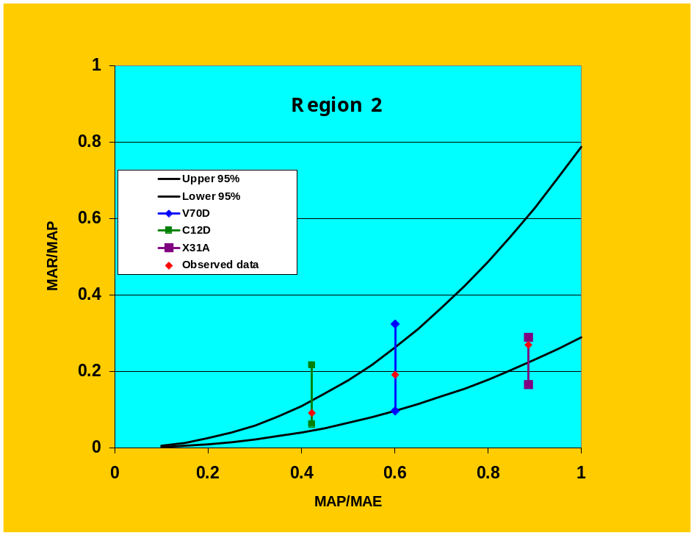
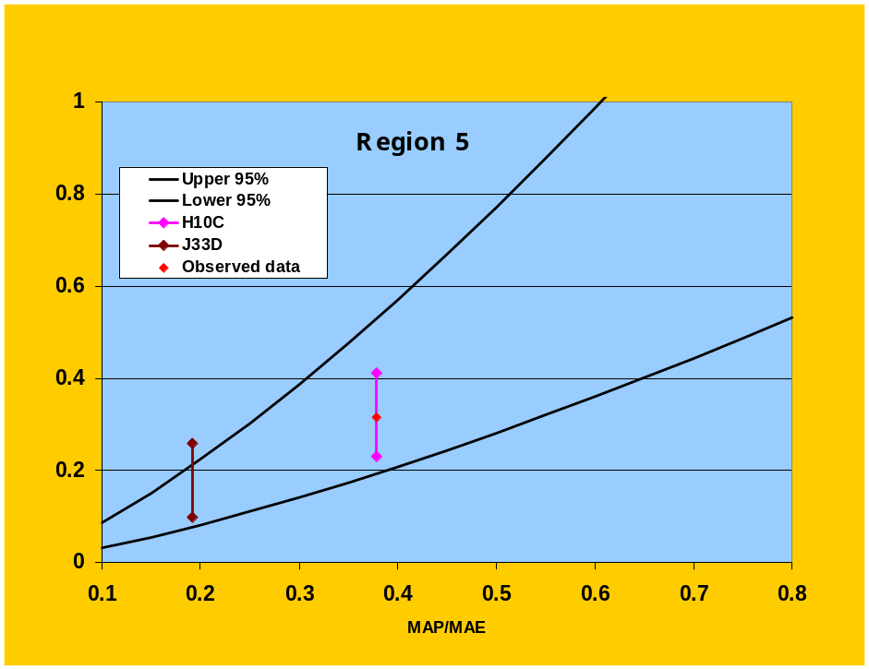
Runoff ratio
Mixed results but generally acceptable
More than 70% accepted as behavioural except for C12D (only 45%)

Slide 14
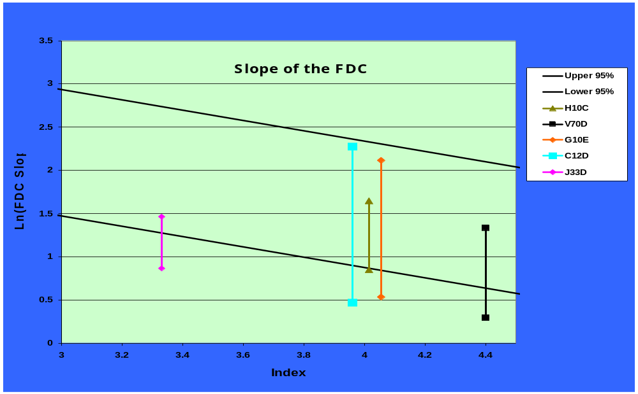
gradient of the FDC
Range of variation is high in all basins except J33D

Slide 15
Summary
The framework
    can work with any model structure
    provides a consistent approach to regional model application and evaluation that explicitly incorporates uncertainty
Preliminary results demonstrate the merits of the framework and suggest that the use of regional constraints has a huge potential to improve model application in both gauged and ungauged basins in South Africa.

Slide 16
Summary
More constraints need to be investigated and developed and the current ones may require refinement
Potential to include more than just parameter uncertainty using the same framework
Hoped that the inclusion of uncertainty in water resources estimation will lead to informed decision making by stakeholders

Slide 17
summary
The extension of the same techniques in the rest of southern Africa is not easy:
  Ungauged basins (shrinking networks)
  Data availability and quality discrepancies across the region
Therefore, there is need to find other sources of data that are
  available, of good quality and consistent at the regional scale
It is also apparent that ground-based measuring and monitoring techniques have limited ability to capture the spatial and temporal variation of different hydrological variables at regional and continental scales.

Slide 18
Importance of earth observation data
Recent advances in measuring hydrological variability by means of satellite
  gravimetric techniques (e.g. GRACE) and
  other remote sensing platforms (e.g. TRMM, Landsat and MODIS), and
  ground-based methods
  provide a great potential to estimate spatio-temporal surface water balance, spatially averaged water budgets, hydrodynamics, hydrological processes, and characterisation of groundwater systems in gauged and ungauged basins at regional and global scales.
What kind of data do we need? For our case, direct use or assimilation for:
  parameterisation of models
  development or improvement of constraints
At what scale?
  Spatially – regional, basin,
Format of data?
  Useable format
  No requirement for expertise in geodesy, should be easy to adapt and use

Slide 19
Conclusions
The water cycle operates across all scales, from the global to the smallest stream catchment, and involves the movement of water in terms of precipitation, evaporation, transpiration, vapour transport, surface runoff, subsurface return flow and groundwater flow.
Accurate knowledge and accounting of these processes (evapotranspiration, rainfall, runoff, and seepage, etc) and different factors (land-use changes) affecting these hydrological processes, both spatially and temporally, is of paramount importance.
There is need for conjunctive use of all possible sources of data to improve our estimates of available water resources and decision making in their management.

Slide 20
THANK YOU

