Slide 1
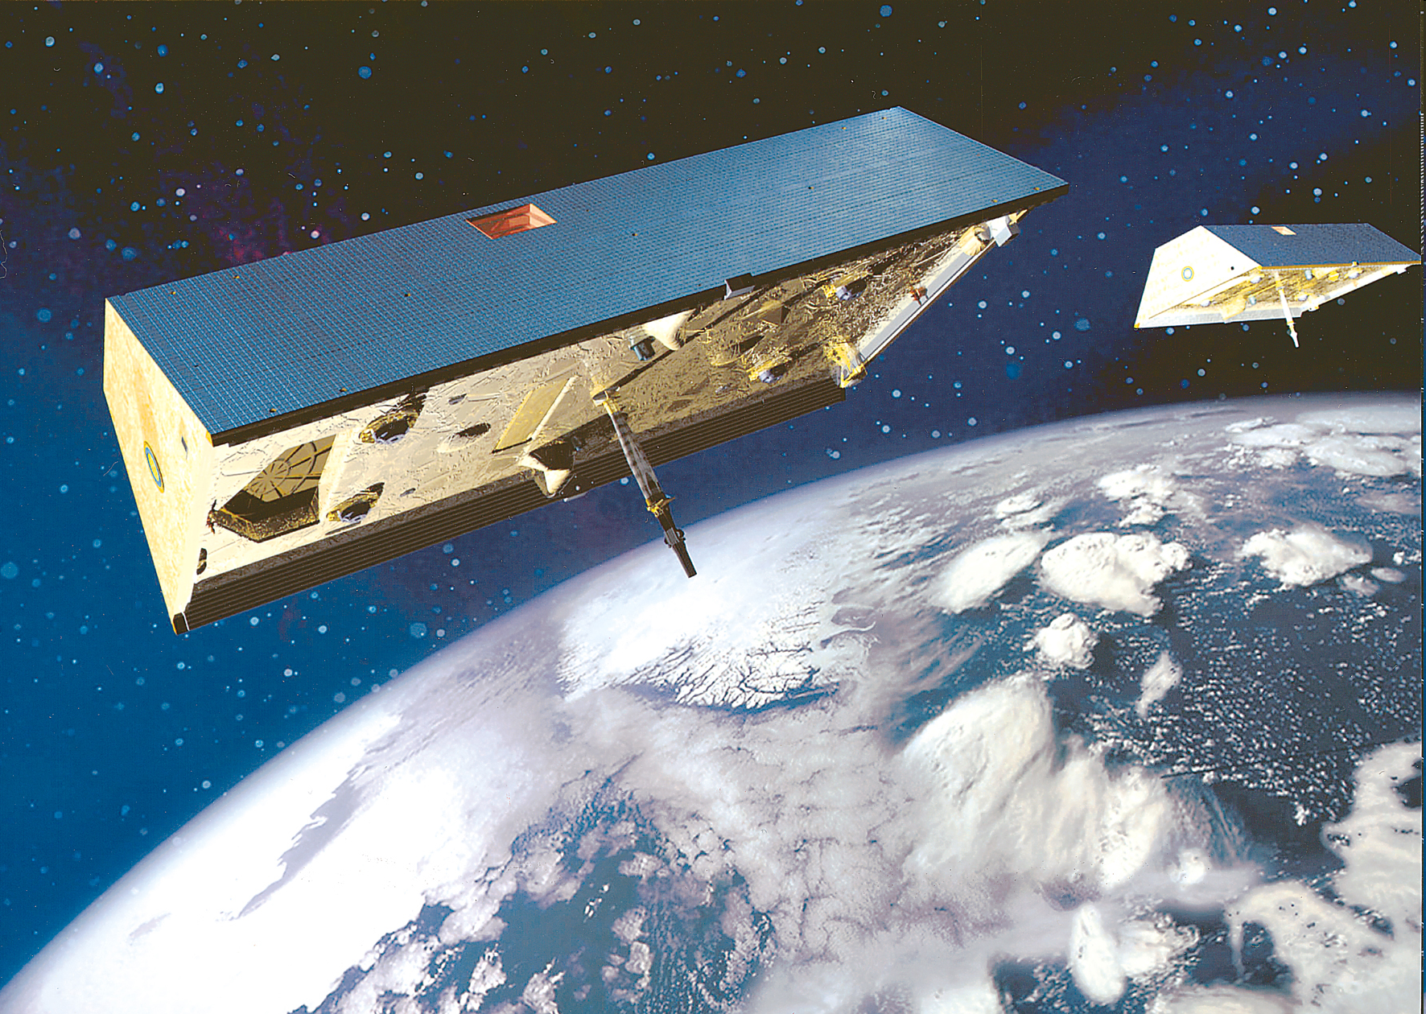

IGCP565 Workshop, Johannesburg, 2012
GRACE products for hydrology
Jürgen Kusche⁽¹⁾, Annette Eicker⁽¹⁾, Henryk Dobslaw⁽²⁾
⁽¹⁾ University of Bonn, ⁽²⁾ GFZ Potsdam
SPP 1257 “Mass Transport and Mass Distribution”

Slide 2
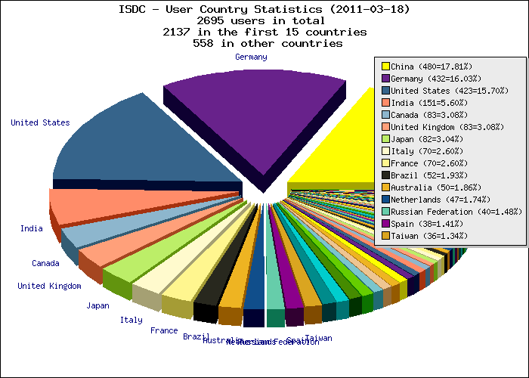
GRACE Status
GRACE Mission Facts
highly successful US/D twin-satellite mission launched in 2002, to monitor mass transport and mass distribution in system Earth
PI: Byron Tapley (University of Texas, Center for Space Research), Co-PI: Dr. Frank Flechtner (GFZ Potsdam)
Has celebrated ist 10th birthday on March 17, 2012
Will likely end its operation in the next 1-3 years (depending on battery status and solar activity)
Will be continued in 2017 by GRACE-FO (NASA/GFZ)
  KBR
  LRI
April 2011:
2700 users registered at GFZ/ISDC
(16% from Germany/China/USA each)
700+ publications (many Nature/Science)
Notes:
2

Slide 3
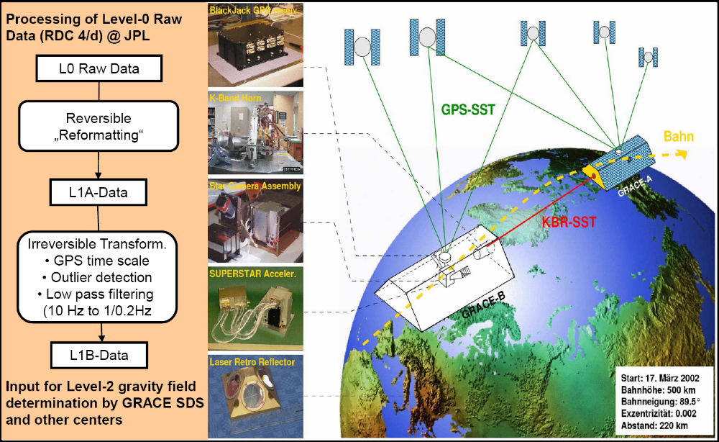
GRACE Status
GRACE Mission Facts
Generation of GRACE Standard L1a/b Products (Flechtner 9/11)
Notes:
3

Slide 4
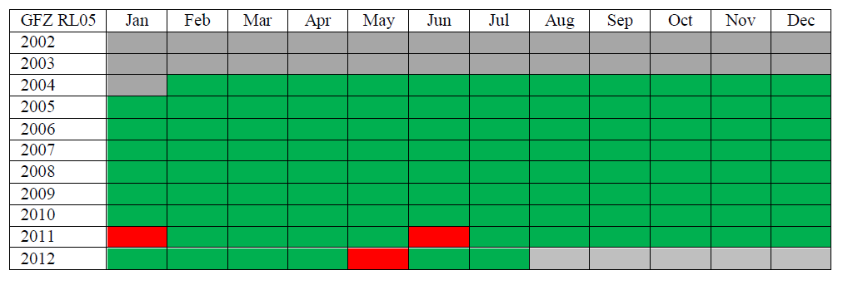
GRACE Status
GRACE Health Status
Degraded battery capacity (cell failure), otherwise healthy
Every 161 days (Sun in orbital plane), battery use is limited (→ maximize lifetime)
http://www.csr.utexas.edu/grace/operations/mission_status/
GRACE SDS Newsletter 8/2012 (availability for GFZ solutions, similar for CSR and JPL)
Notes:
4

Slide 5
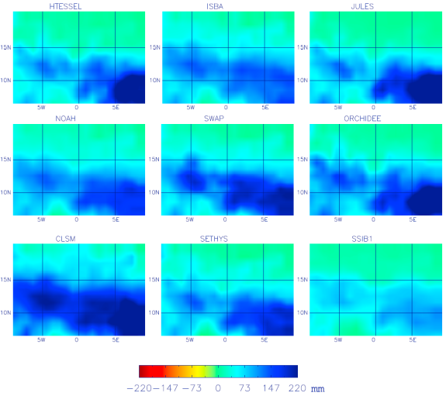
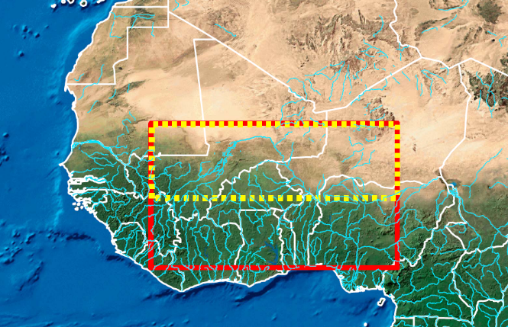
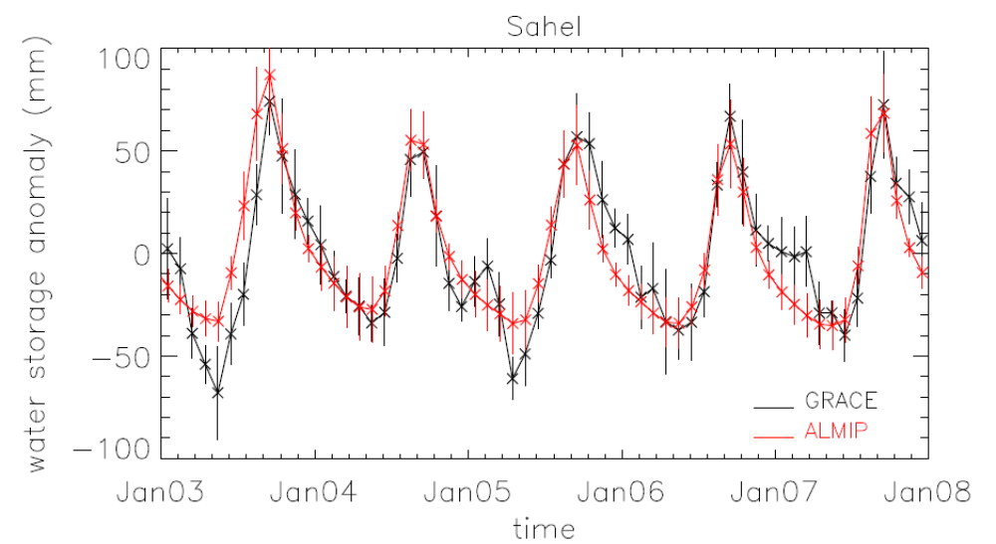
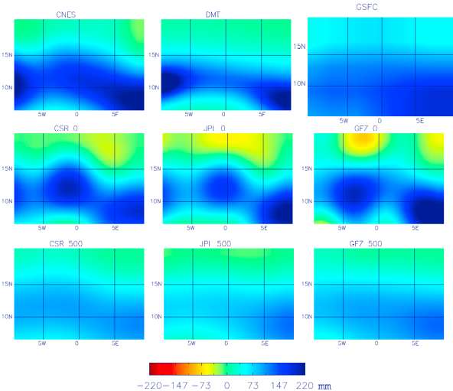
GRACE Science Results for Africa
Hydrology –Grippa et al. (2011): TWS from 6 GRACE solutions, different post-processing, and 9 LSMs
- multimodel averaging is difficult to justify -
LSM
GRACE
Notes:
5
Time series is average over all well sites, since 2003: GRACE – GLDAS – Problem: GRACE as well as GLDAS are considered as truth, and there is little
comparison (owing to the data situation)

Slide 6
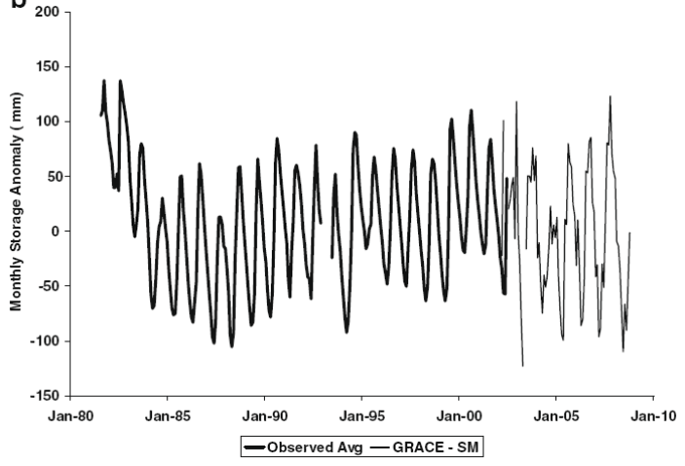
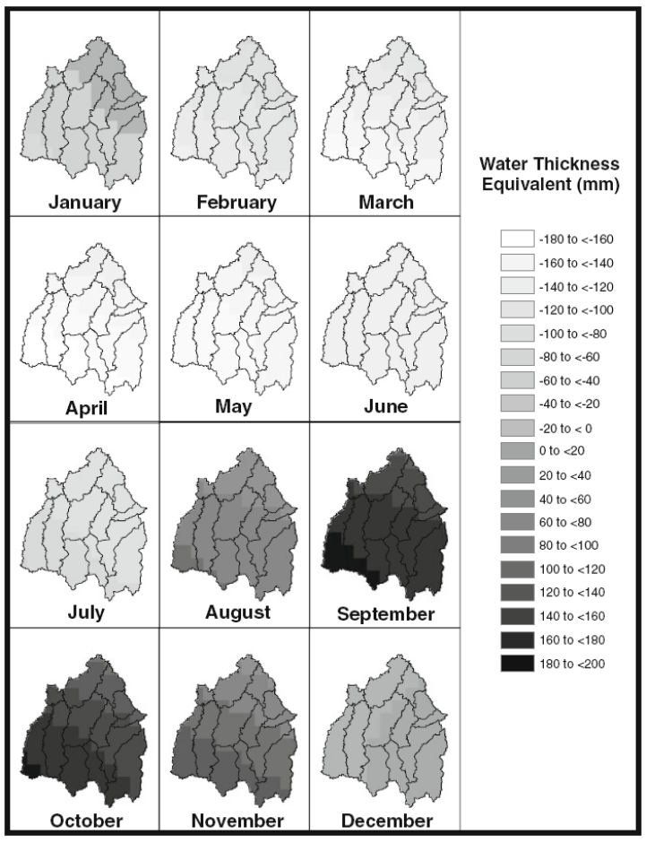
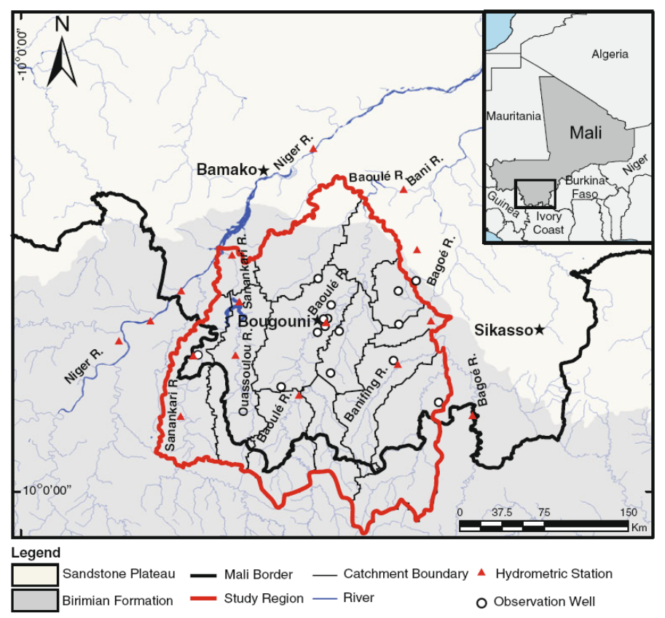
GRACE Science Results for Africa
Hydrology – Henry et al. (2011):
GRACE TWS – GLDAS Soil moisure = Groundwater variation
Avg. GW
Notes:
6
Time series is average over all well sites, since 2003: GRACE – GLDAS – Problem: GRACE as well as GLDAS are considered as truth, and there is little
comparison (owing to the data situation)

Slide 7
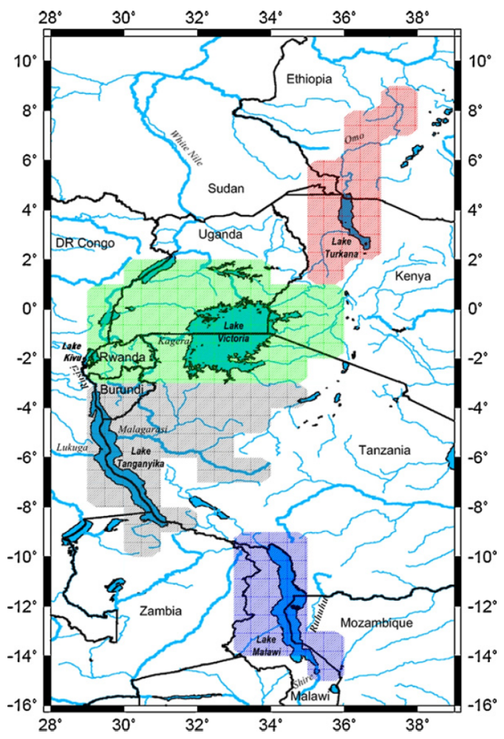
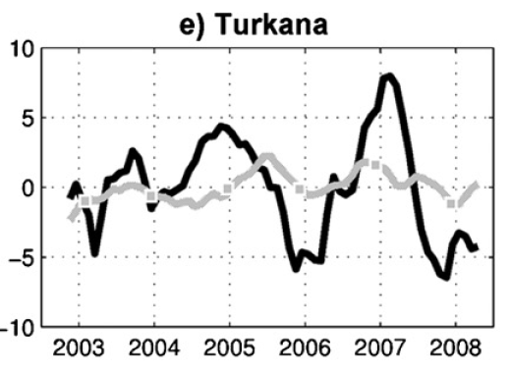
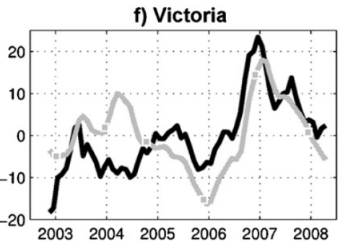
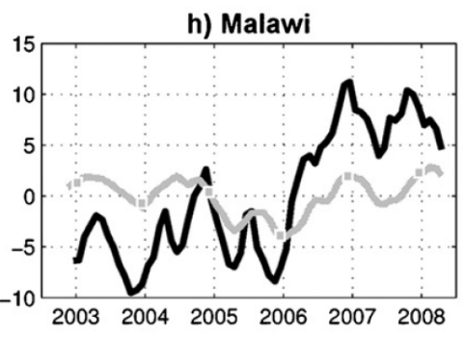

GRACE Science Results for Africa
Hydrology – Becker et
al. (2010,
C.R. Geoscience)
Notes:
7

Slide 8
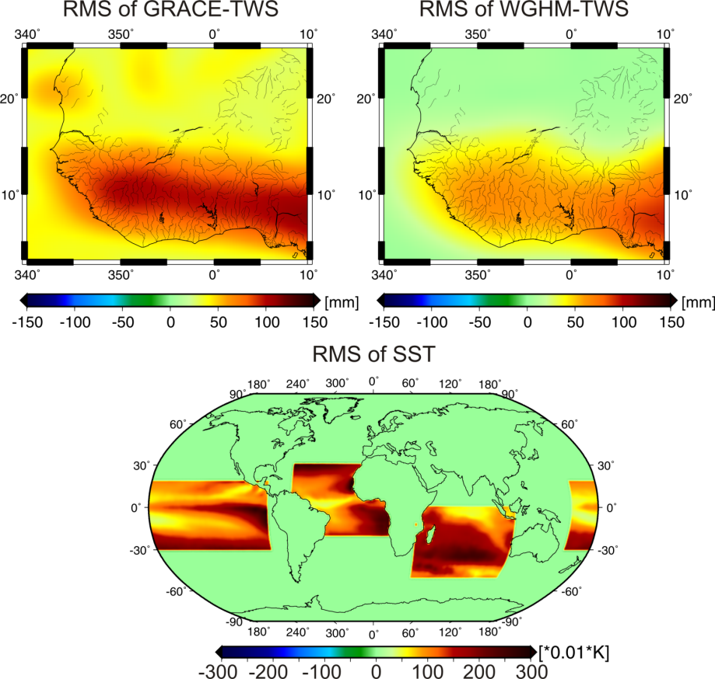
GRACE Science Results for Africa
Idea
Can we describe the GRACE maps over West-Africa by just a few statistically independent modes?
Are these modes related to modes of Tropical Atlantic sea surface temperature? (we would expect this from GCMs)
If yes, can we build a forecast approach for TWS on these modes
Inputs
  GRACE
  SST
  Hydrology model (validation)
Methods
  ICA for extracting modes
  Fitting of AR-models
Forootan, Eicker, Kusche, Diekkrüger, … (U Bonn)
Notes:
8

Slide 9
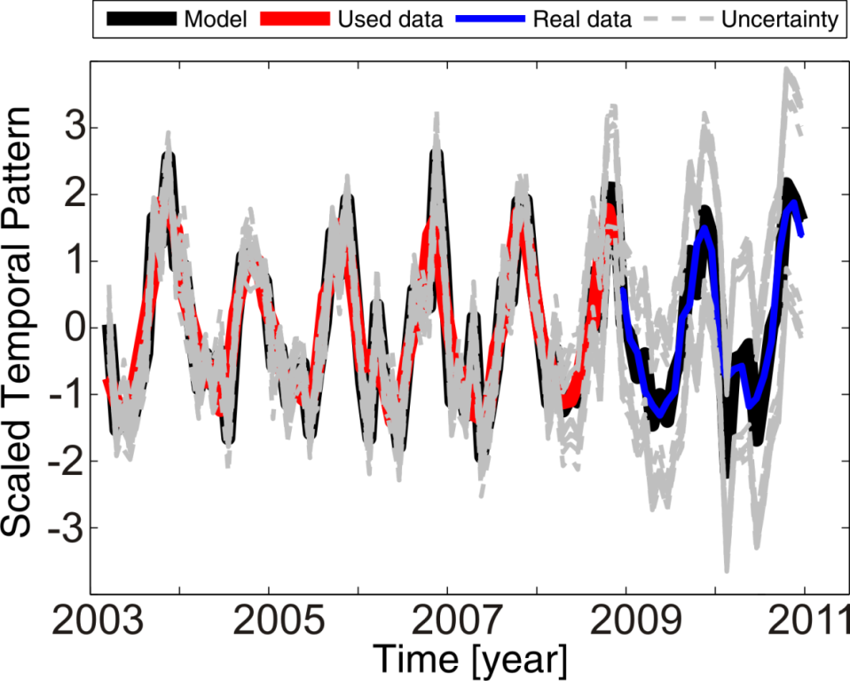
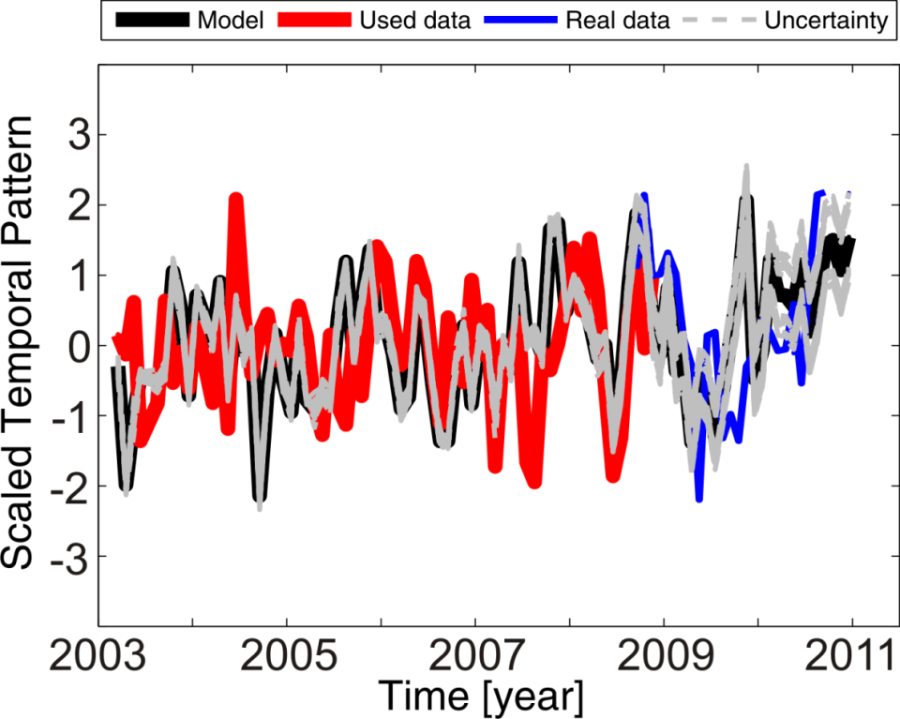
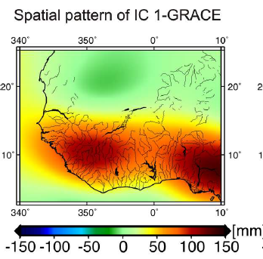
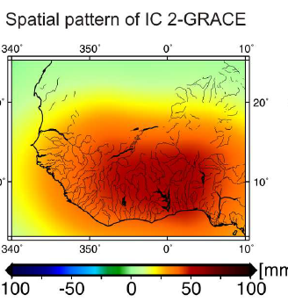
GRACE Science Results for Africa
Forootan, Eicker, Kusche, Diekkrüger, … (U Bonn)
GRACE Mode 2 related to mode 2 of Atlantic SST
GRACE mode 3 isolates mode 3 in Pacific SST
Simple AR-forecast works well for up to two years
Notes:
9

Slide 10
GRACE Science Results for Africa
Upcoming: university-driven proposal to DFG: Look into
long-term changes,
extreme events,
anthropogenic feedbacks,
feedbacks in water-energy cycle
Regions
Southern Europe
Monsoon (West) Africa
with
Hydrogeodesy
Hydrological modelling
Meteorological remote sensing and modelling
Notes:
10

Slide 11
GRACE Data Products
GRACE standard products
L2 level: Monthly SH expansions of gravity potential V
User interest (I)
„L3 level“: Monthly maps of equivalent water heights (can be derived from L2 standard products)
User interest (II)
Enhance temporal and/or spatial resolution
Minimize leakage of mass variation outside area of interest
Combine with in-situ data
→ Nonstandard products
  Special L1-L2 processing approaches
  Development of postprocessing
Notes:
11

Slide 12
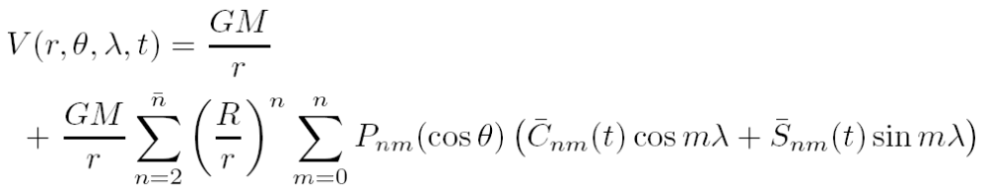


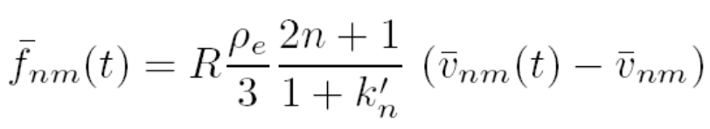

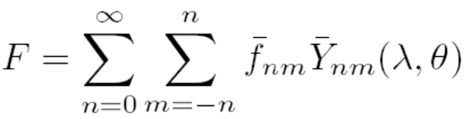
GRACE Standard Products & How to use them
Monthly sets of spherical harmonics. TWS from GRACE
Issues
SH resolution
Latency and gaps
Processing
AOD-Products
Degree-1 and C20
Solid Earth Response
(Love numbers/ Geophysical model)
EWH maps
Notes:
12

Slide 13
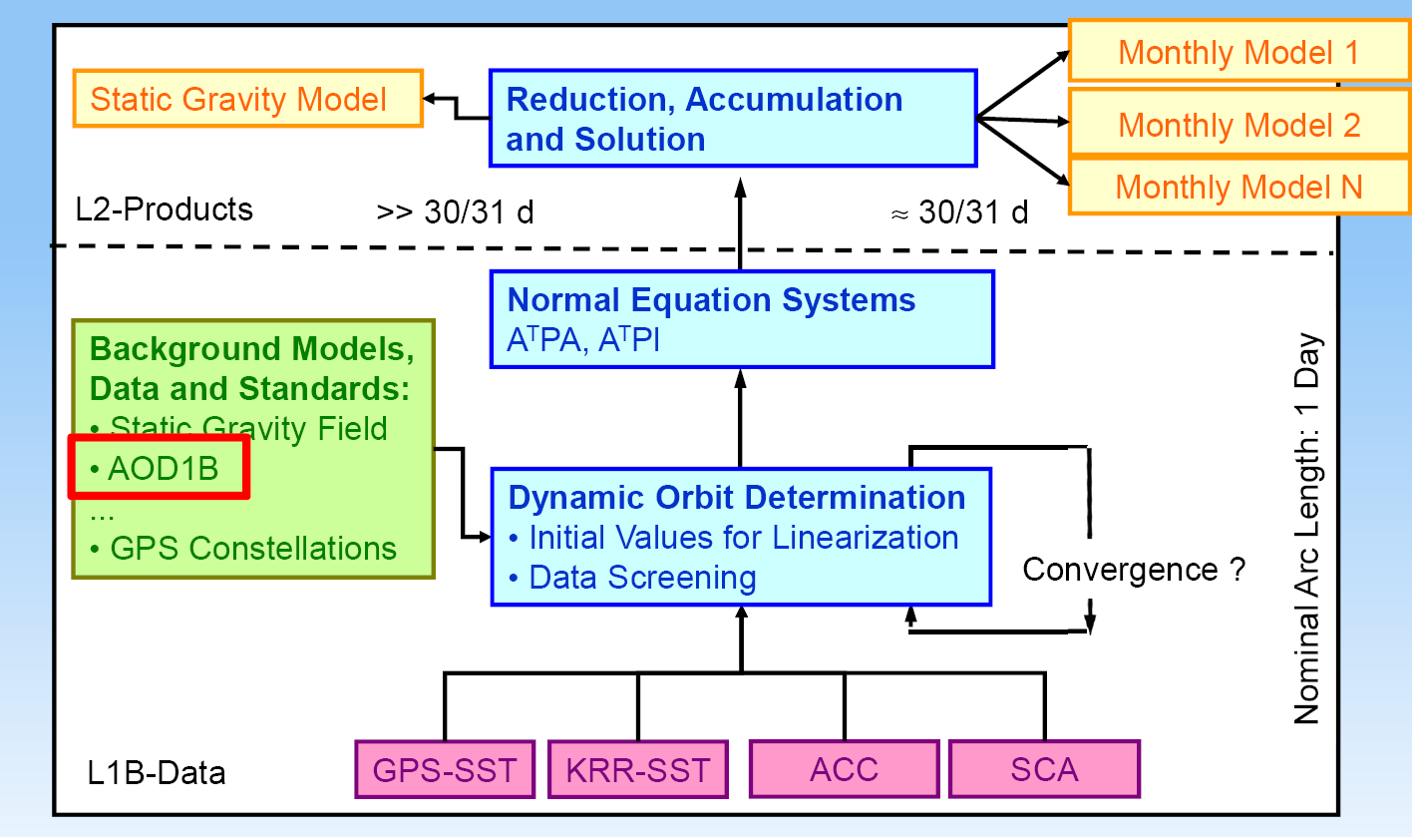
GRACE Standard Products & How to use them
Generation of GRACE Standard L2 Products (Flechtner 9/11)
Notes:
13

Slide 14
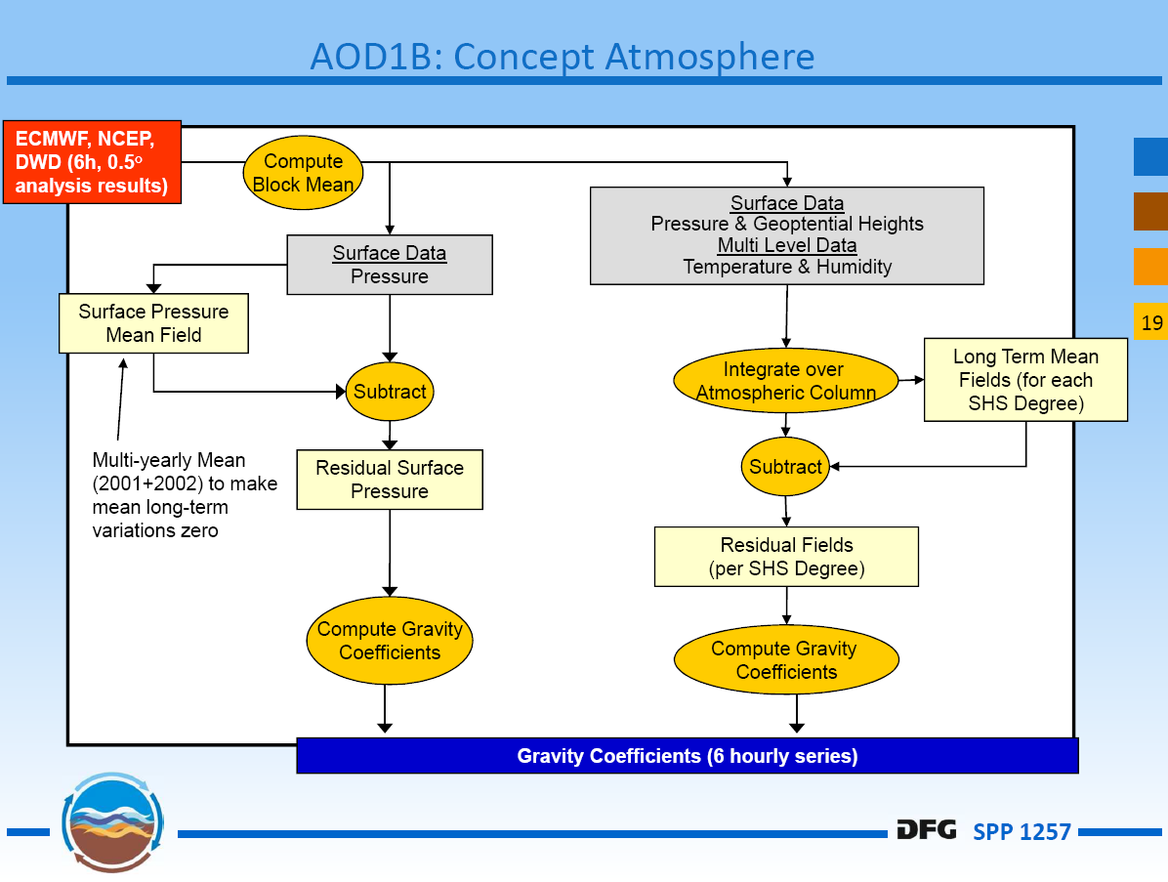
GRACE Standard Products & How to use them
Generation of GRACE Standard AODB Products (Flechtner 9/11)
Notes:
14

Slide 15
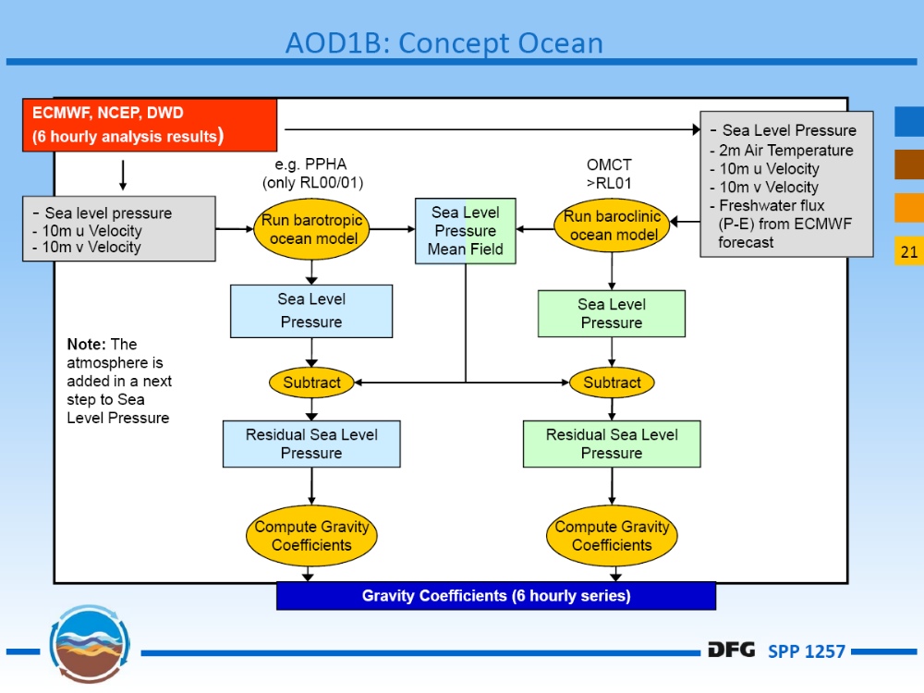
GRACE Standard Products & How to use them
Generation of GRACE Standard AODB Products (Flechtner 9/11)
Notes:
15

Slide 16
GRACE Non-Standard Products & Procedures
Enhanced temporal resolution
Daily GRACE solutions
Weekly GRACE solutions
Monthly GRACE solutions
Enhanced spatio-temporal resolution
Masscon solutions
RBF solutions
Notes:
16

Slide 17
GRACE Non-Standard Products & Procedures
From L1 data to L2/“L3“ data
Geophysical model
(loading)
L1 data (KBR, GPS,
ACC, ATT)
Intermediate functional
(LOS acc., potential
difference, …)
Gravity potential
parameterization
EWH
parameterization
Geophysical
background models
Satellite altitude
Earth‘s surface
Modified from Panet et al (2009)
Notes:
17

Slide 18
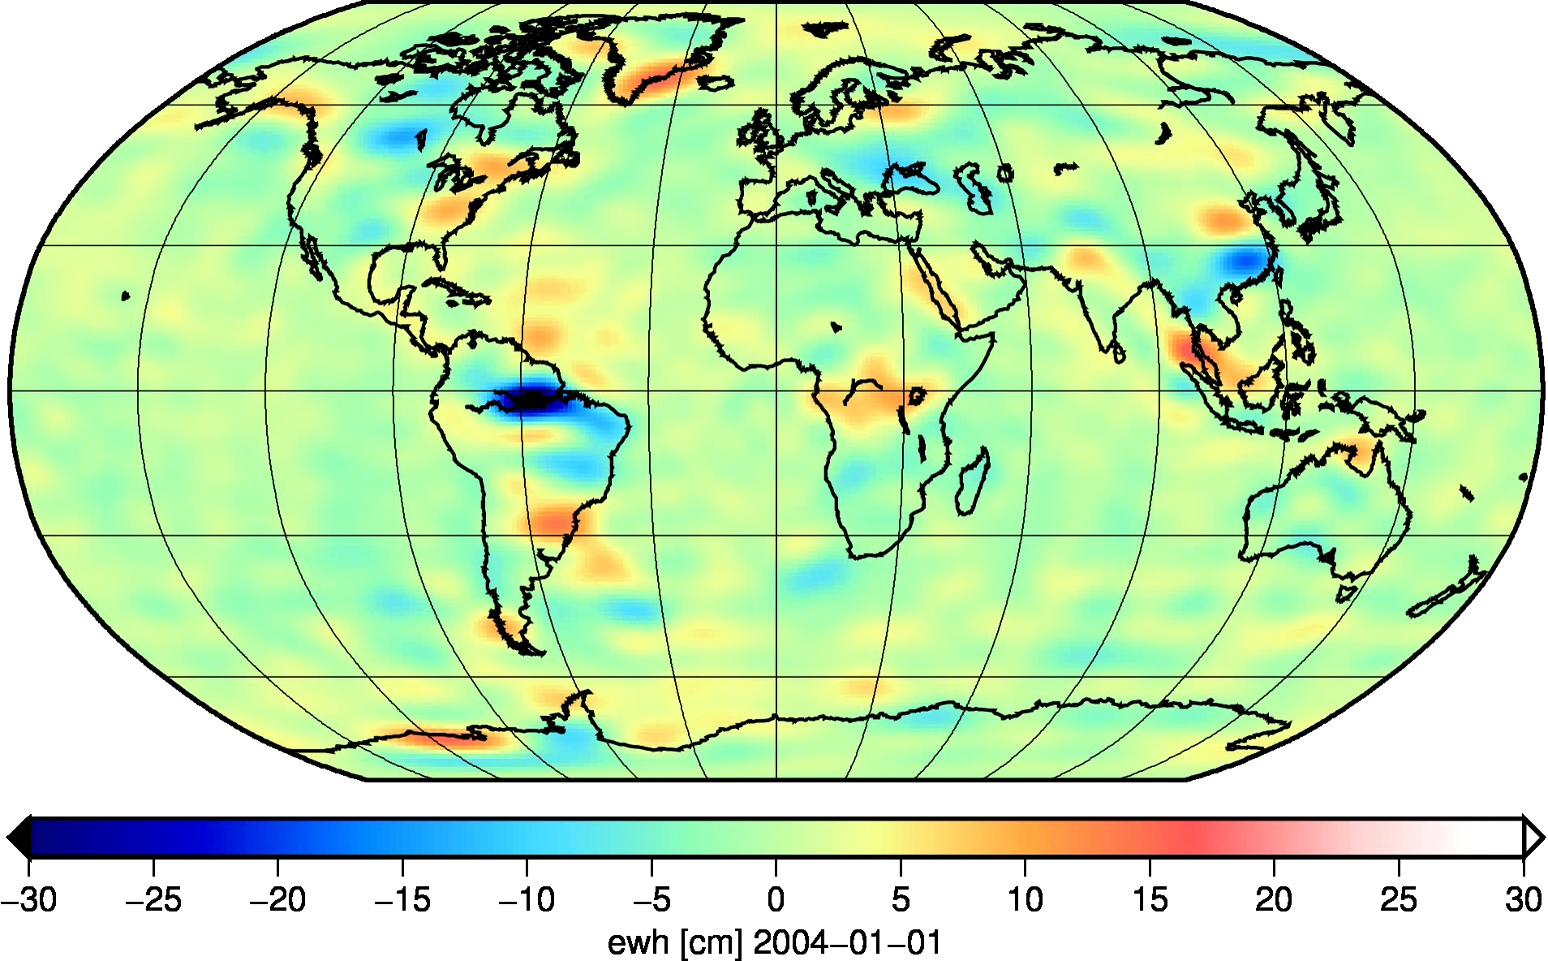
GRACE Non-Standard Products & Procedures
Daily GRACE SH solutions (Bonn University, Kurtenbach et al, 2009)
Low spatial resolution but high temporal resolution
Not a combination, uses only stochastic constraints
Used as well in de-aliasing of ITG2010 monthly solutions
Notes:
18

Slide 19
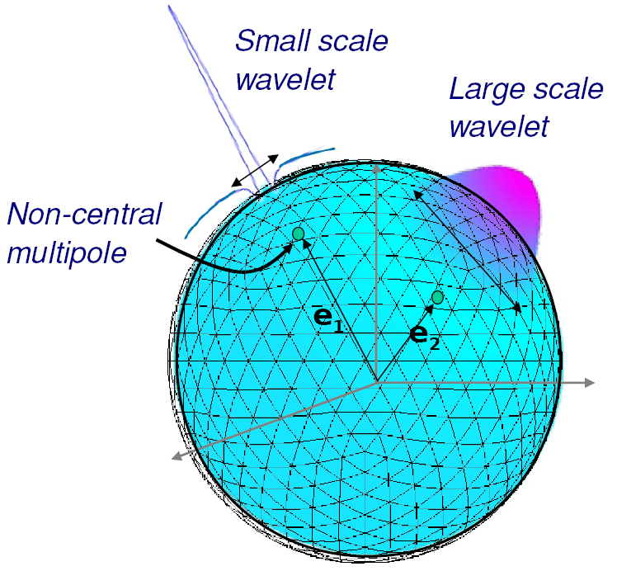
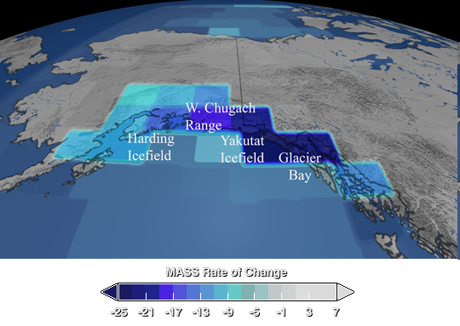
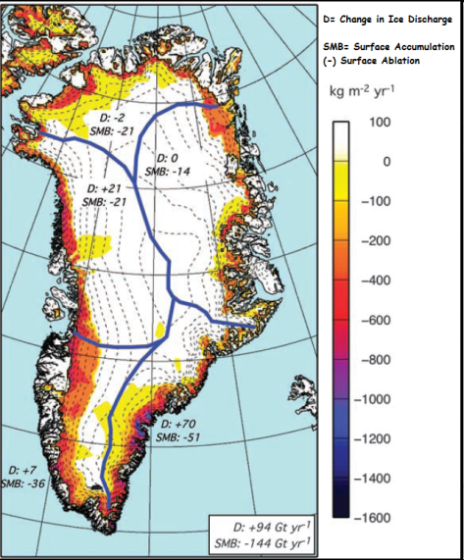
GRACE Non-Standard Products & Procedures
Enhanced spatio-temporal resolution („regional“ approaches“, using regional constraints)
RBF solutions (Eicker, Holschneider,…)
  Compute a harmonic gravity model (L2) with less base functions, avoiding SH expansion, L3 EWH using Love numbers
Masscon solutions (Rowlands, Ramillien, …)
  Direct modelization of EWH (L3) or use of SH expansion
Basin-shaped „masscons“ (Wouters, Sandberg-Sørensen…)
  Derived from gridded L2 products at altitude
Notes:
19

Slide 20
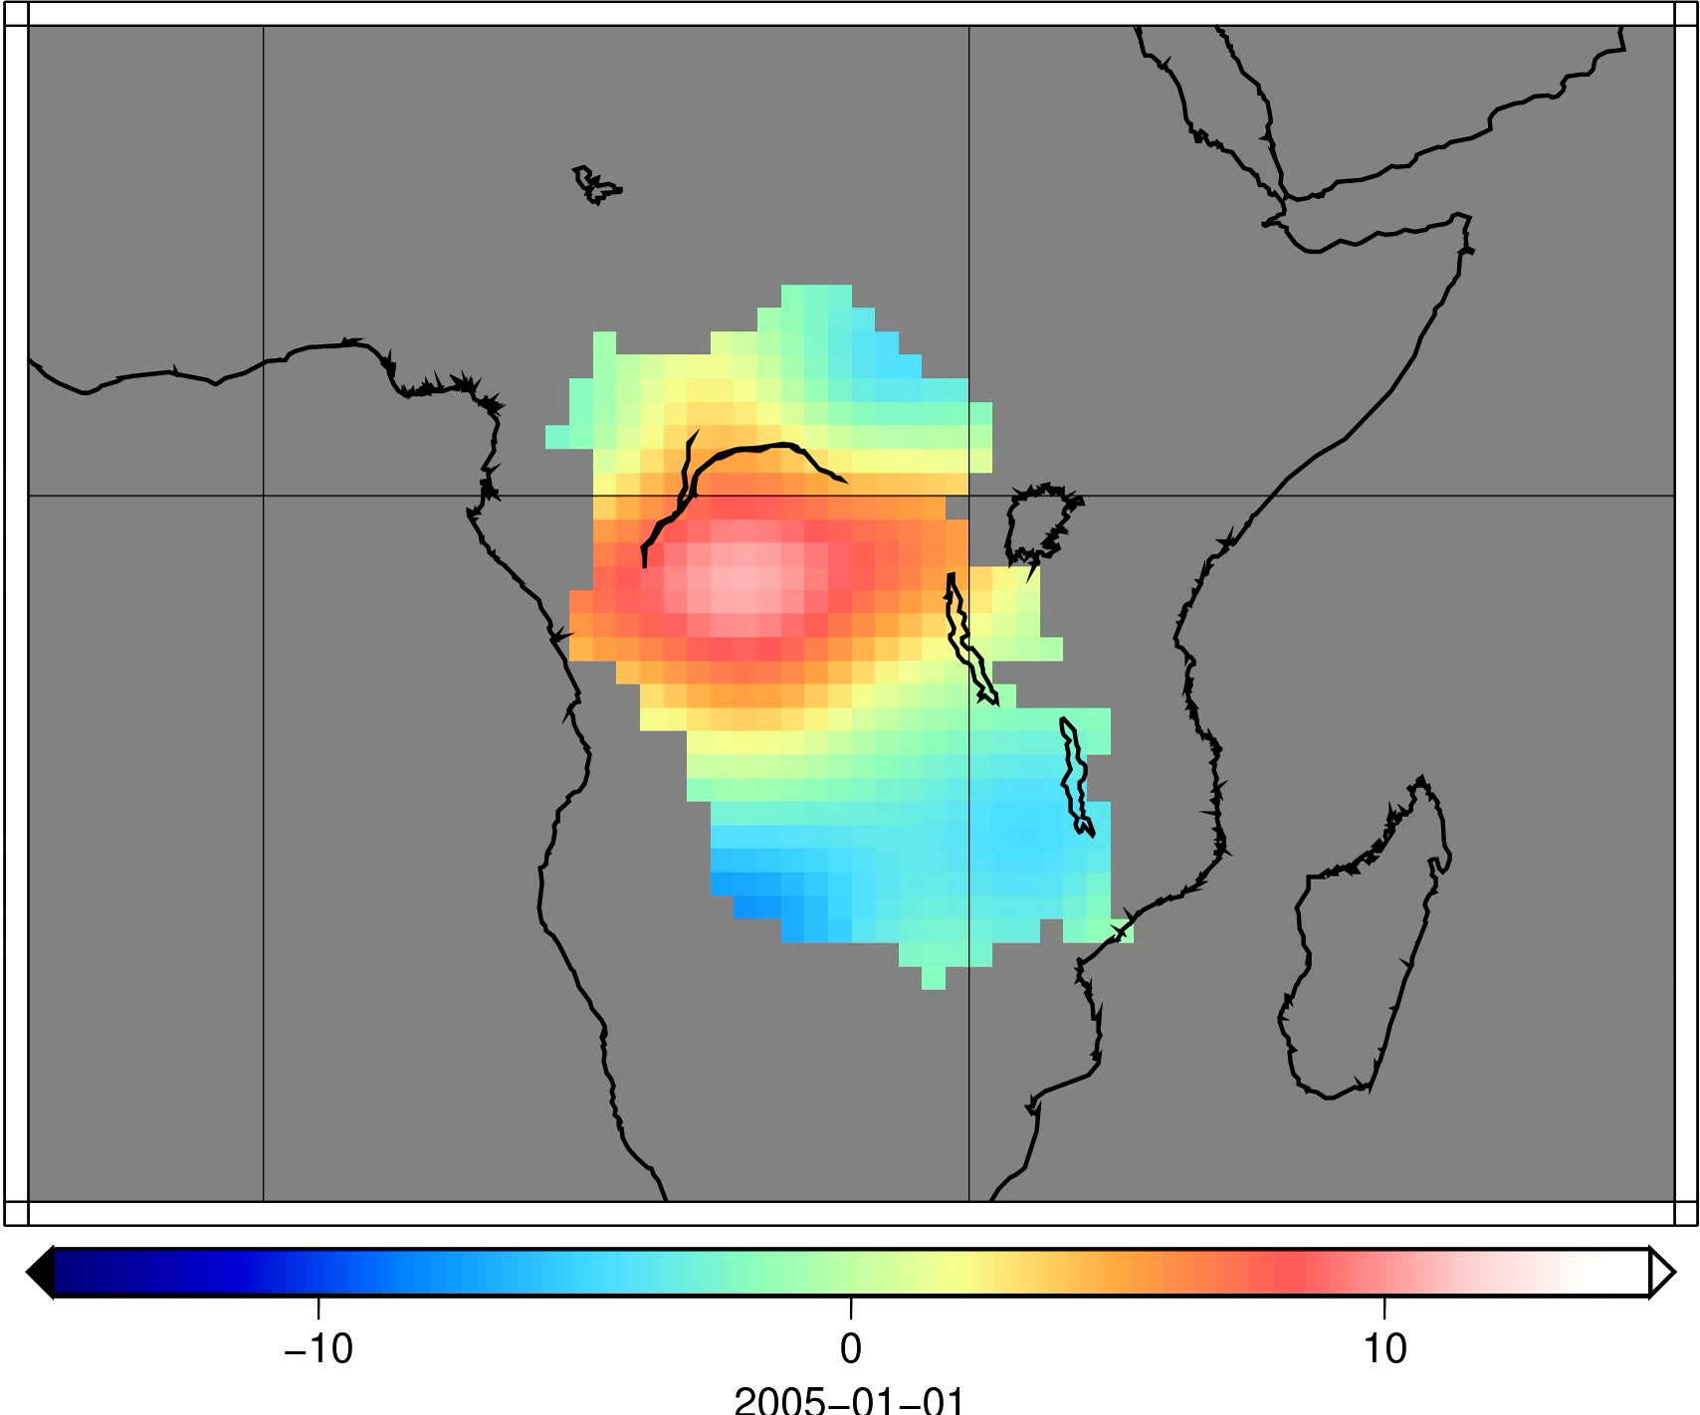
GRACE Non-Standard Products & Procedures
RBF solutions (Eicker et al, Uni Bonn)
Compute a harmonic gravity model (L2) with less base functions, avoiding SH expansion, L3 EWH using Love numbers
Notes:
20

Slide 21
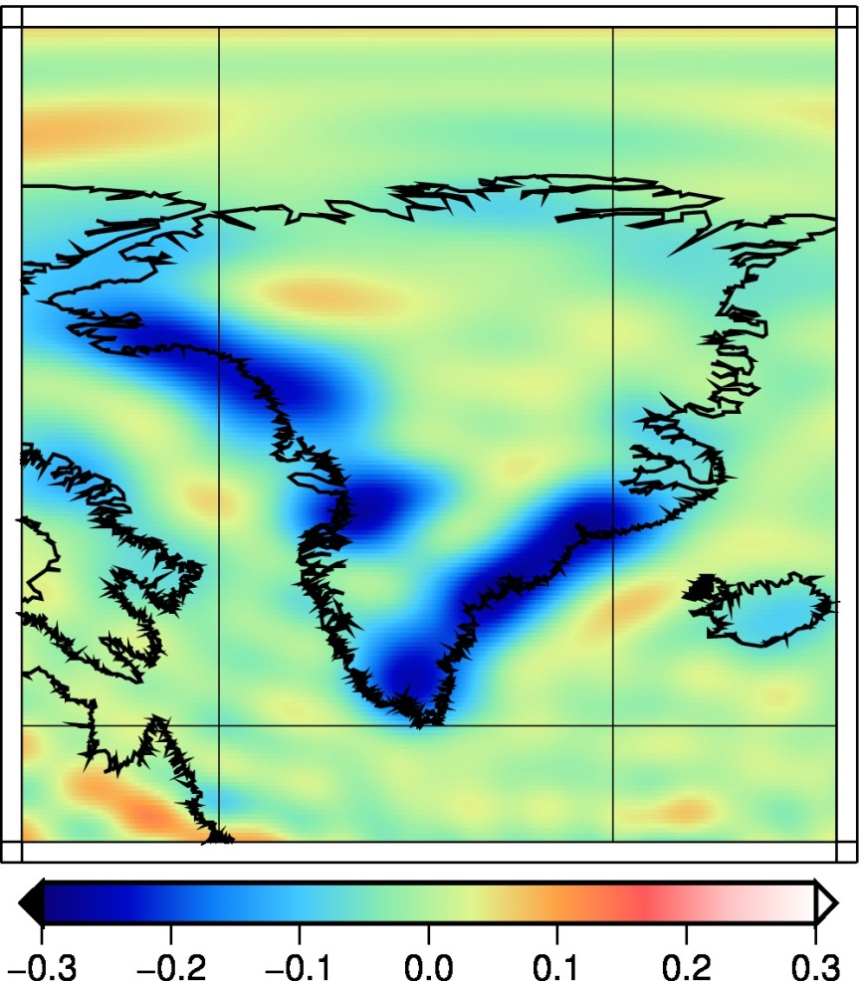
GRACE Non-Standard Products & Procedures
RBF solutions (Eicker et al, Uni Bonn)
100km resolution appears possible
Notes:
21

Slide 22
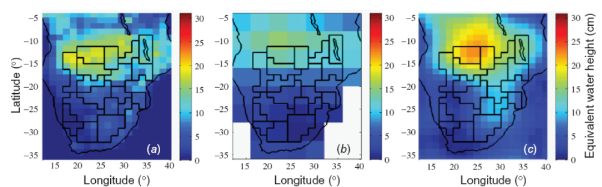
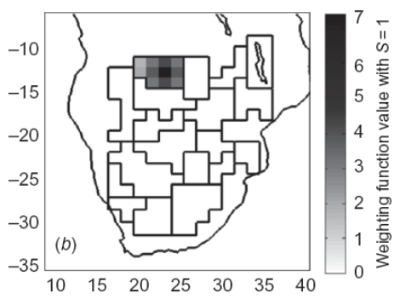
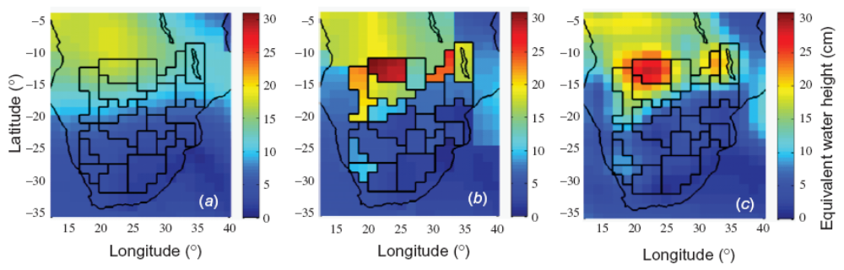
GRACE Non-Standard Products & Procedures
Masscon solutions (standard 4ºx4º, isotropic constraints)
Krogh et al (2011), 10d x 1.5º/1.25º x 1º, regional constraints (RC)
GLDAS
4º mascon
GRGS-50
1.5º mascon
mascon RC
mascon RC-50
Notes:
22

Slide 23
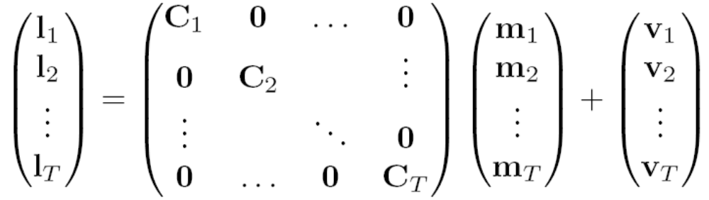





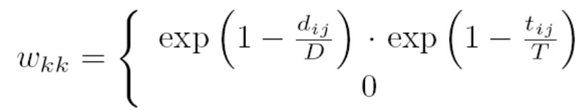

GRACE Non-Standard Products & Procedures
Fundamental difference: Implementation of constraints in the
masscon approach (Rowlands et al 2010, Sabaka et al 2010)
Notes:
23

Slide 24
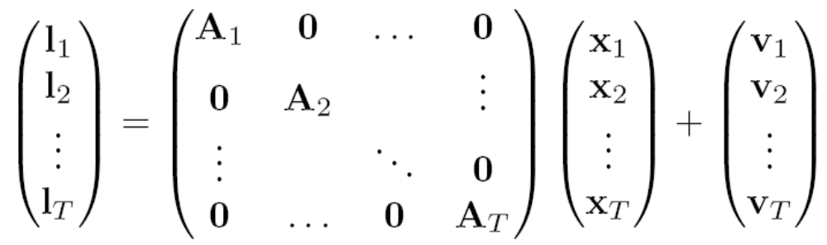


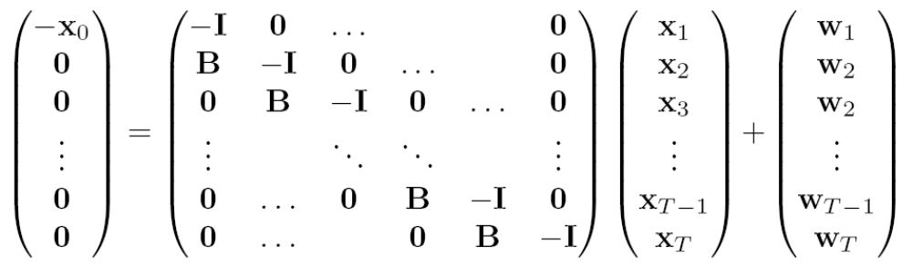

GRACE Non-Standard Products & Procedures
Fundamental difference: Implementation of constraints in the
RBF/Kalman filter approach (Eicker 2008, Kurtenbach 2011)
Notes:
24

Slide 25
Take-home Message (I)
GRACE has provided a unique opportunity for geodesy and hydrology
With GRACE-FO in reach, and developments starting for missions beyond, we‘re hopefully heading towards an operational chain of gravity/mass missions (as in altimetry)
Future missions will likely push the spatial resolution of GRACE down to 150-200km
Through a series of reprocessings and through development of non-standard products, GRACE product quality has strongly increased
Notes:
25

Slide 26
AOD1B
OMCT: Ocean General Circulation Model (OGCM) based on HOPE-C (E. Maier-Reimer) from MPI for Meteorology, Hamburg
- impact of tides on the ocean general circulation (Thomas et al., 2001)
- contribution of ocean dynamics to Earth rotation variability (Thomas, 2002)
- de-aliasing of ocean mass variability for GRACE (Dobslaw, 2007)
AOD RL04 is based on a OMCT version as of Jan, 2006
weaknesses in RL04 series have emerged during the years (e.g., Bonin & Chambers, 2011)
validation database has been substantially improved since 2006: in-situ pressure gauges, satellite altimetry, GRACE solutions with high temporal resolution, etc.
RL05: Several model updates in OMCT (discretization, time step, spin-up, paramterizations)
26
Notes:
26

Slide 27
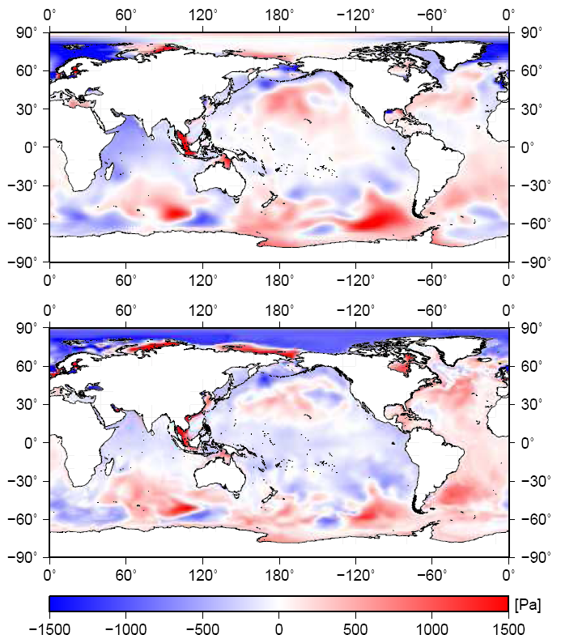
Bottom Pressure Anomalies: Snapshot
Feb 1st, 2008
00:00 UTC
OMCT RL04
OMCT RL05
[Pa]
27
Notes:
27

Slide 28
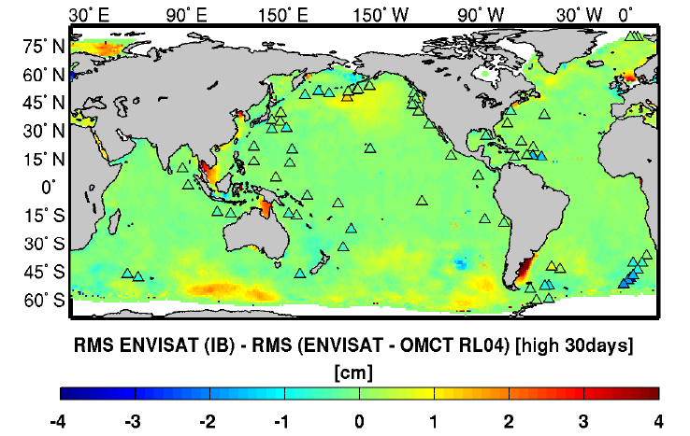
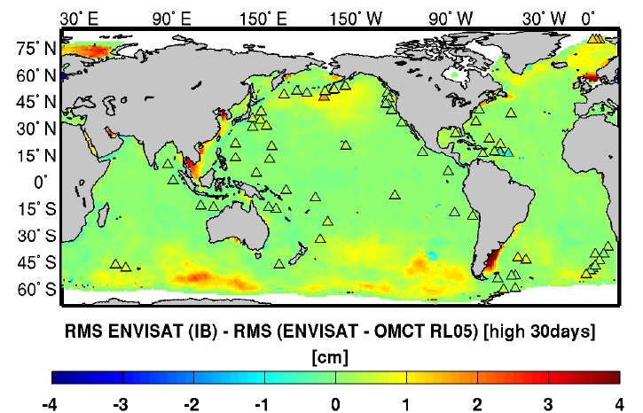
Validation: ENVISAT & in-situ OBP (< 30 days)
OMCT RL04
OMCT RL05
28
Notes:
28

Slide 29
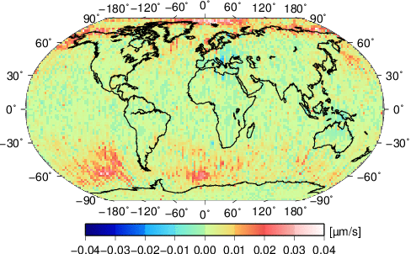
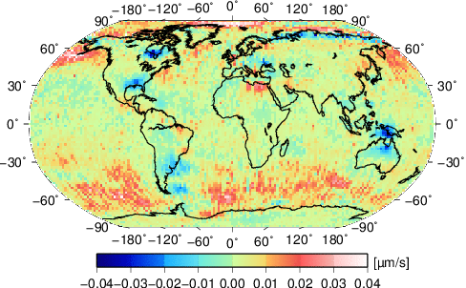
Impact on K-band Range-Rate (kbrr) Residuals
locally averaged (2° x 2°) kbrr residuals
for 2008 (AOD RL04_sm – AOD RL05_sm)
locally averaged (2° x 2°) kbrr residuals
for 2008 (AOD RL04 – AOD RL05)
29
Notes:
29

Slide 30
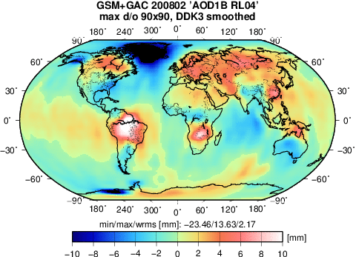
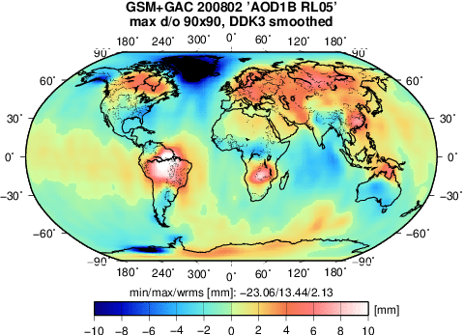
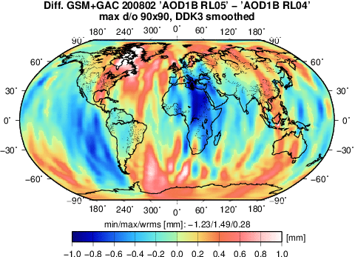
Impact on GRACE gravity fields: GFZ RL05
February
2007
RL05 with AOD1B RL04:
wRMS = 4.91 mm Geoid
RL05 with AOD1B RL05:
wRMS = 4.74 mm Geoid
30
Notes:
30

Slide 31
Take-home message (II)
OMCT bottom pressure series with increased spatial resolution are available for GRACE de-aliasing (AOD1B RL05)
short-term variability is substantially improved wrt. in-situ bottom pressure, and ENVISAT or Jason-1 sea level anomalies
kbrr-residuals are largely reduced over the Southern Ocean, but increase in several shallow water regions (primarily related to trends)
new AOD contributes to the lower noise level in re-processed GRACE RL05 monthly solutions
Future
consider ERA Interim atmospheric data: no discontinuities, but time-series is only sequentially updated with some months latency
Consideration of numerical improvements for the 3D integration of atmospheric masses suggested by Forootan et al. (JGR, under review)
31

