Slide 1

Coseismic gravity changes by the 2010 Chile earthquake: separating hydrological and tectonic signals in GRACE data
and postseismic
Kosuke Heki & Koji Matsuo
Dept. Natural History Sci., Hokkaido Univ.

Slide 2
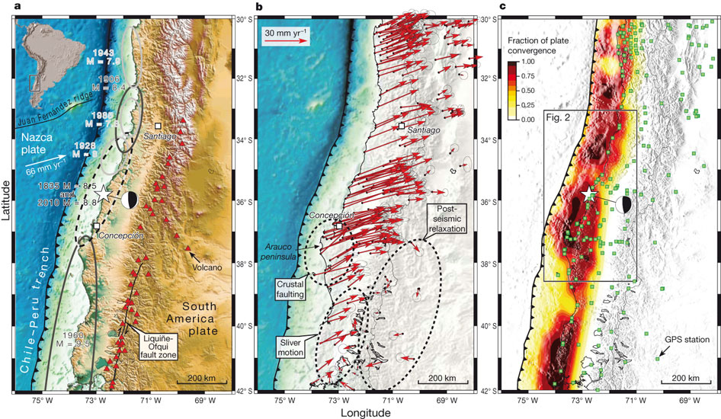
2010 Chile Earthquake : an expected event at a known seismic gap
Constitución-Concepción Seismic Gap
(last rupture in 1835)
A
B
Interseismic crustal movement and coupling (Moreno et al., Nature 2010)

Slide 3
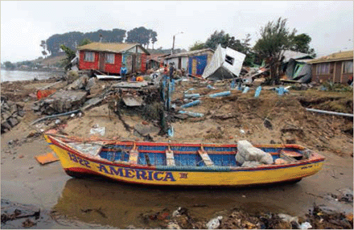
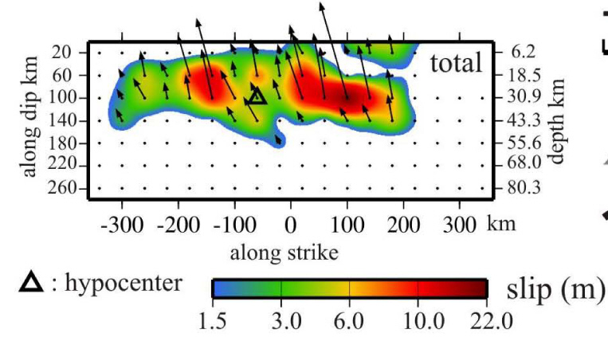
Madariaga et al., Science, 2010
2010 Chile Earthquake
(Maule Earthquake)
Coseismic slip distribution (Delouis et al., GRL, 2010)
B
A

Slide 4
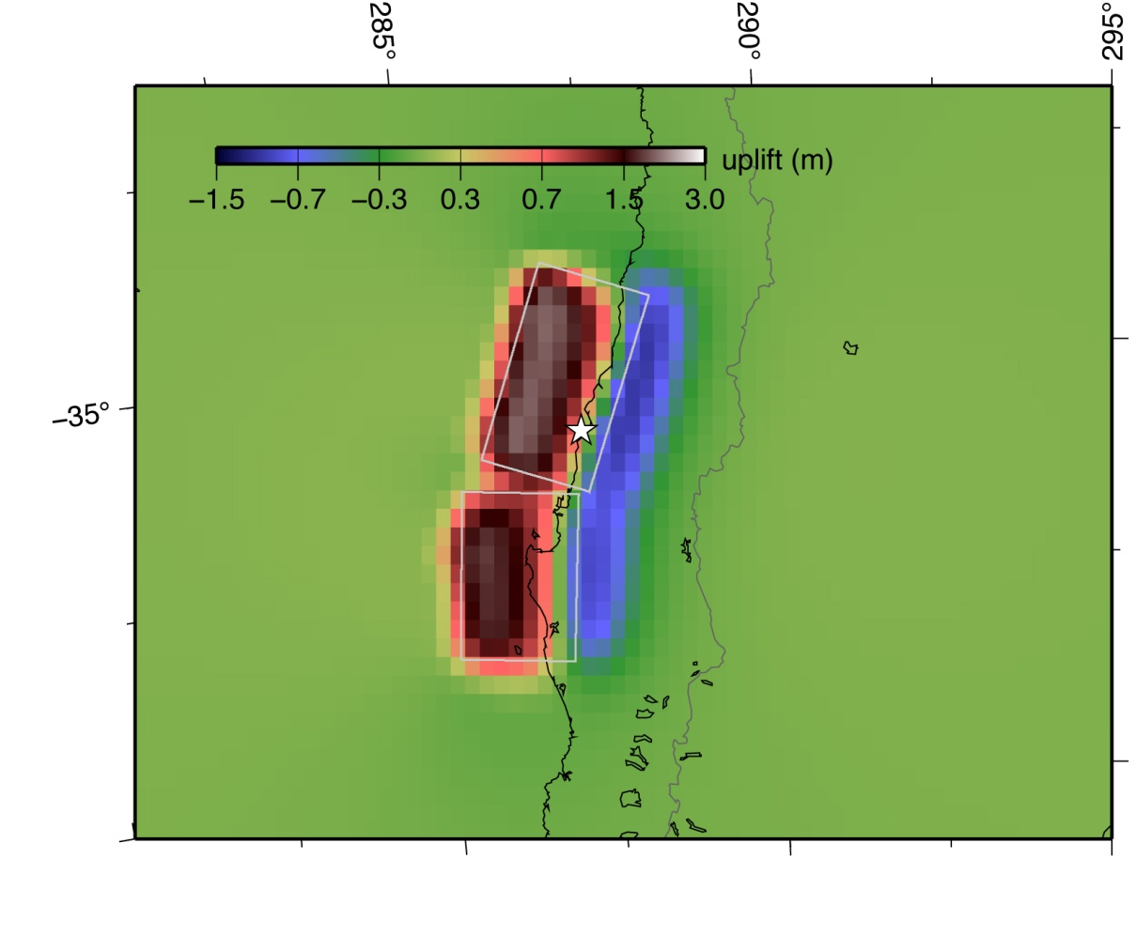
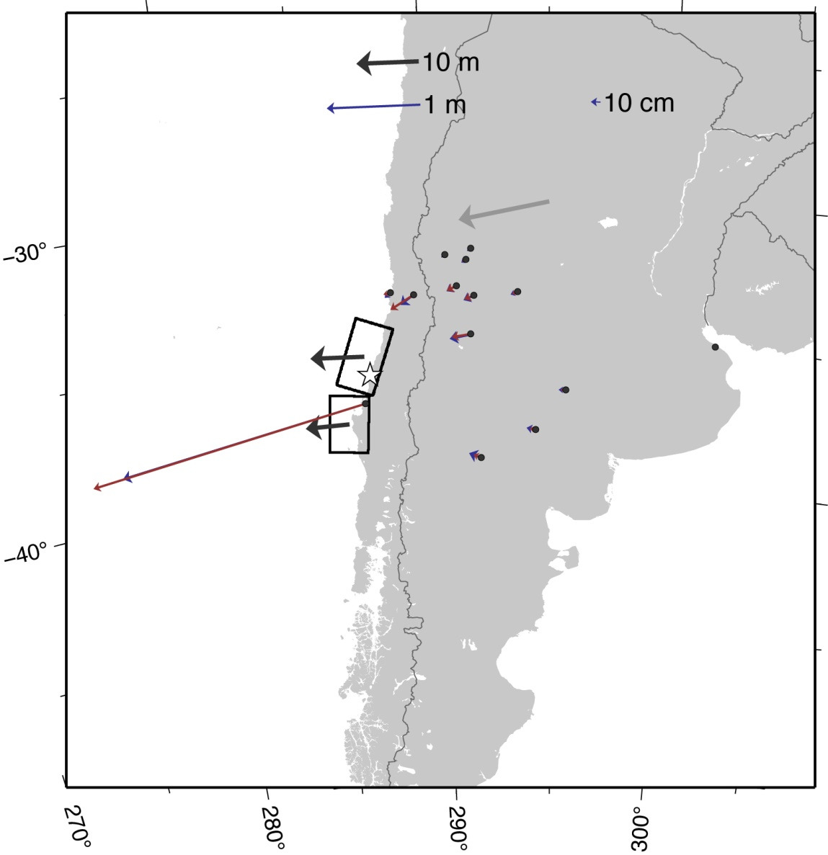
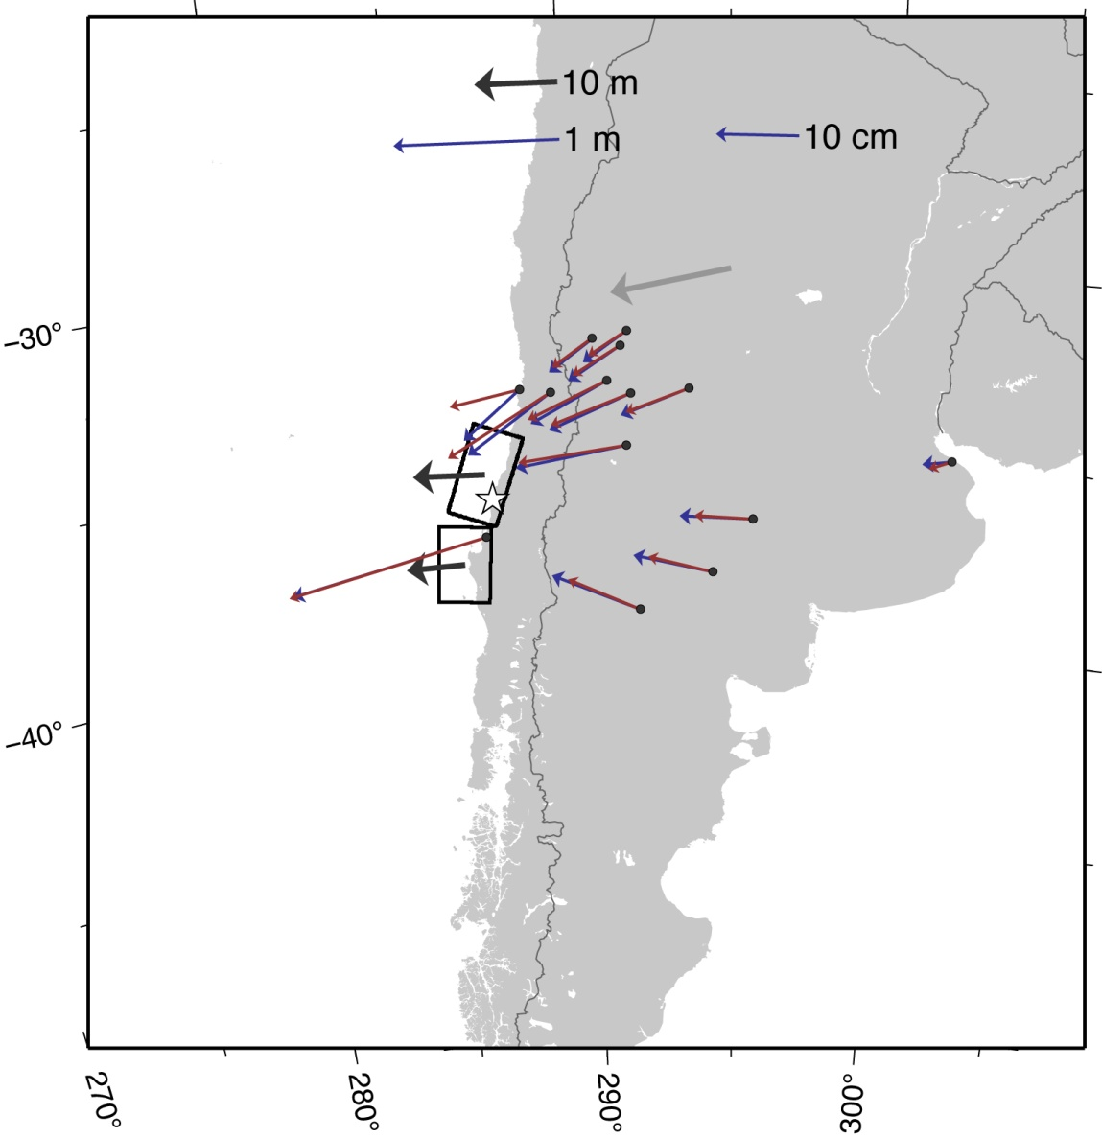
Logarithmic
Linear
A
B
Concepción
Vertical movement
obs.
calc.
Horizontal movement
Surface displacement
GPS data by Delouis et al. [2010, GRL]

Slide 5
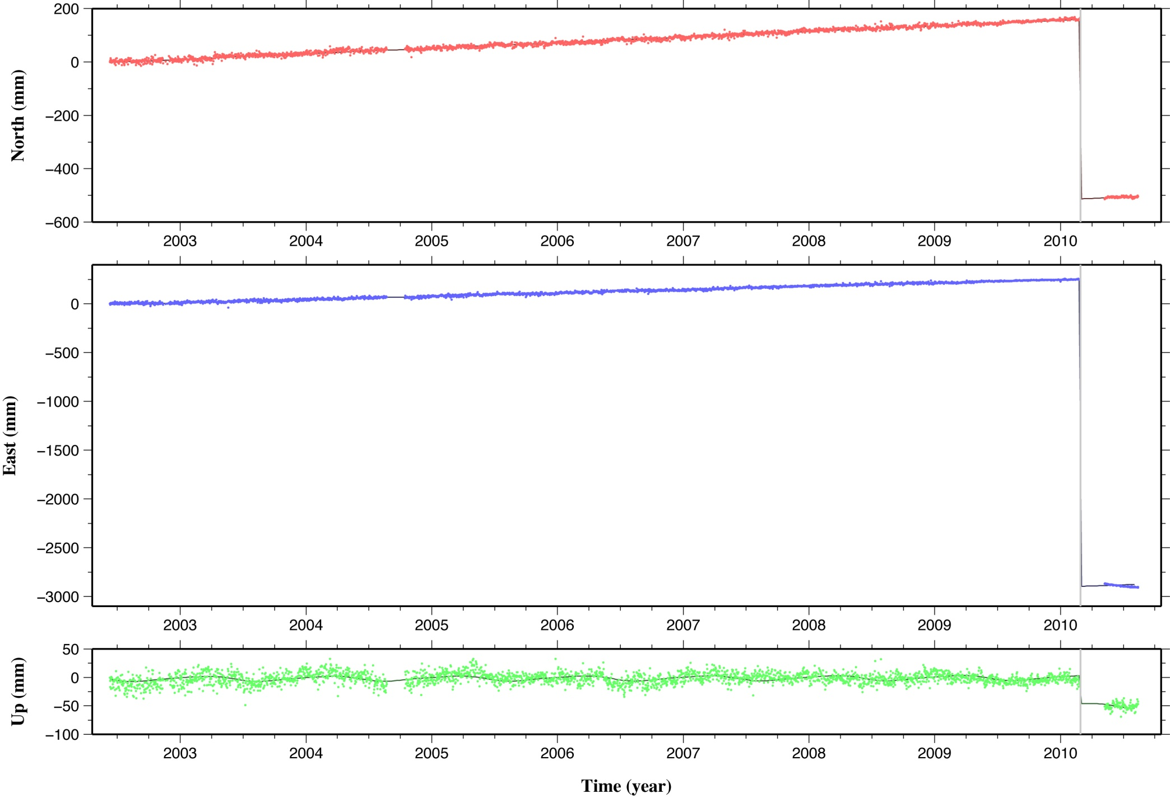
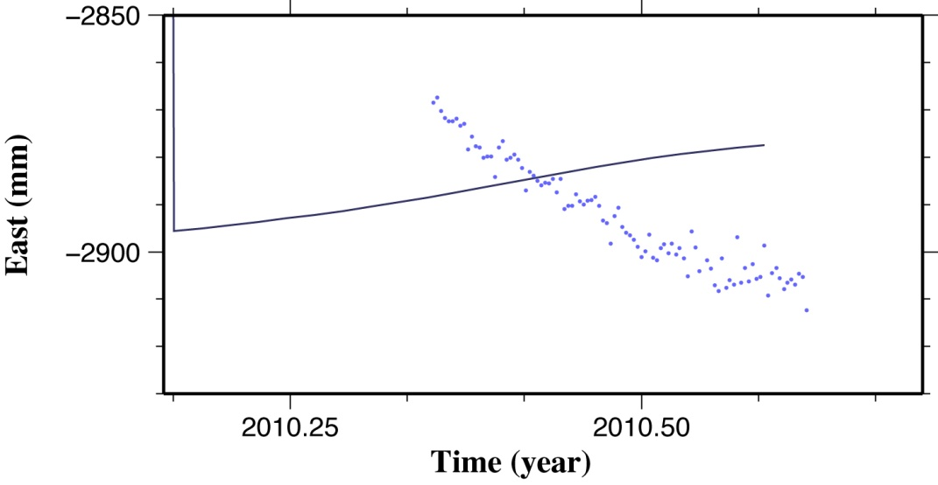
Concepicón GPS station time series (http://sopac.ucsd.edu)
Concepción
Coseismic displacement > 2 meters
Vertical movement
(Moderate) afterslip
Vertical displacement only ~5 cm

Slide 6
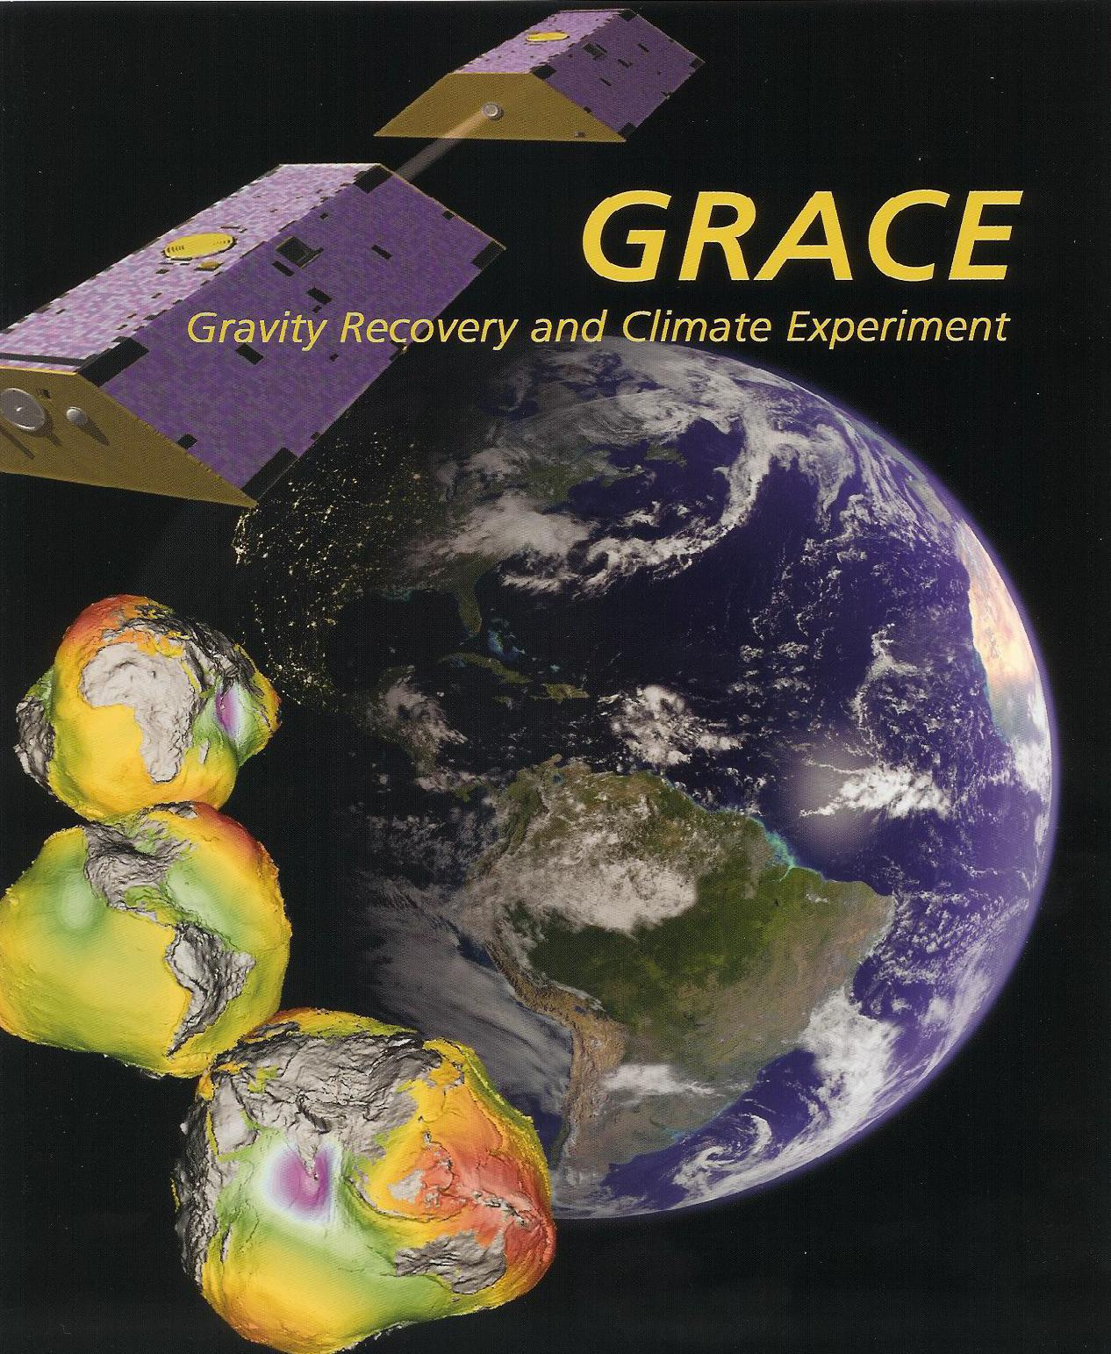
Earthquakes
and
Gravity Changes

Slide 7
Coseismic Mass Perturbation
1. Surface uplift (+subsidence)
Crust
3. Crustal dilatation
2. Moho subsidence (+uplift)
4. Mantle compression
Mantle
Notes:
There are four factors responsible for the gravity change.

Slide 8
Interplate thrust earthquake causes both gravity increase and decrease
(short wavelength) (long wavelength)
Uplift due to horizontal convergence
lithosphere
Downward movement of lithosphere

Slide 9
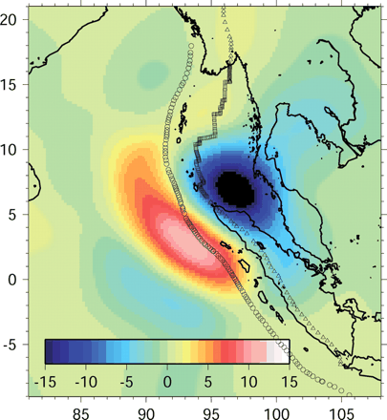
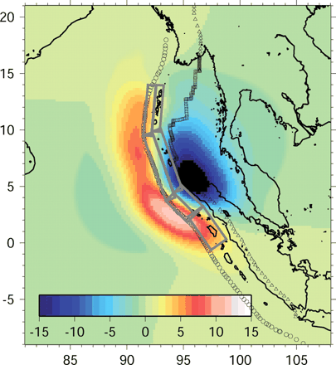
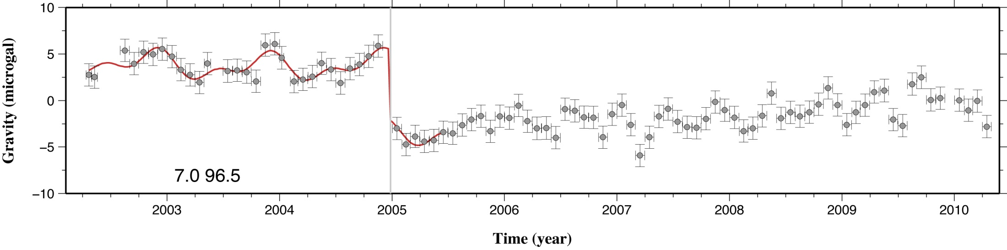
Coseismic gravity change of the 2004 Sumatra Eq.
(Han et al., Science, 2006)
Observed with GRACE
Predicted
-7.6 ± 0.9 μgal
Unit: microgal
Notes:
Coseismic gravity change was first observed by satellite for the 2004 Sumatra-Andaman Eq.

Slide 10
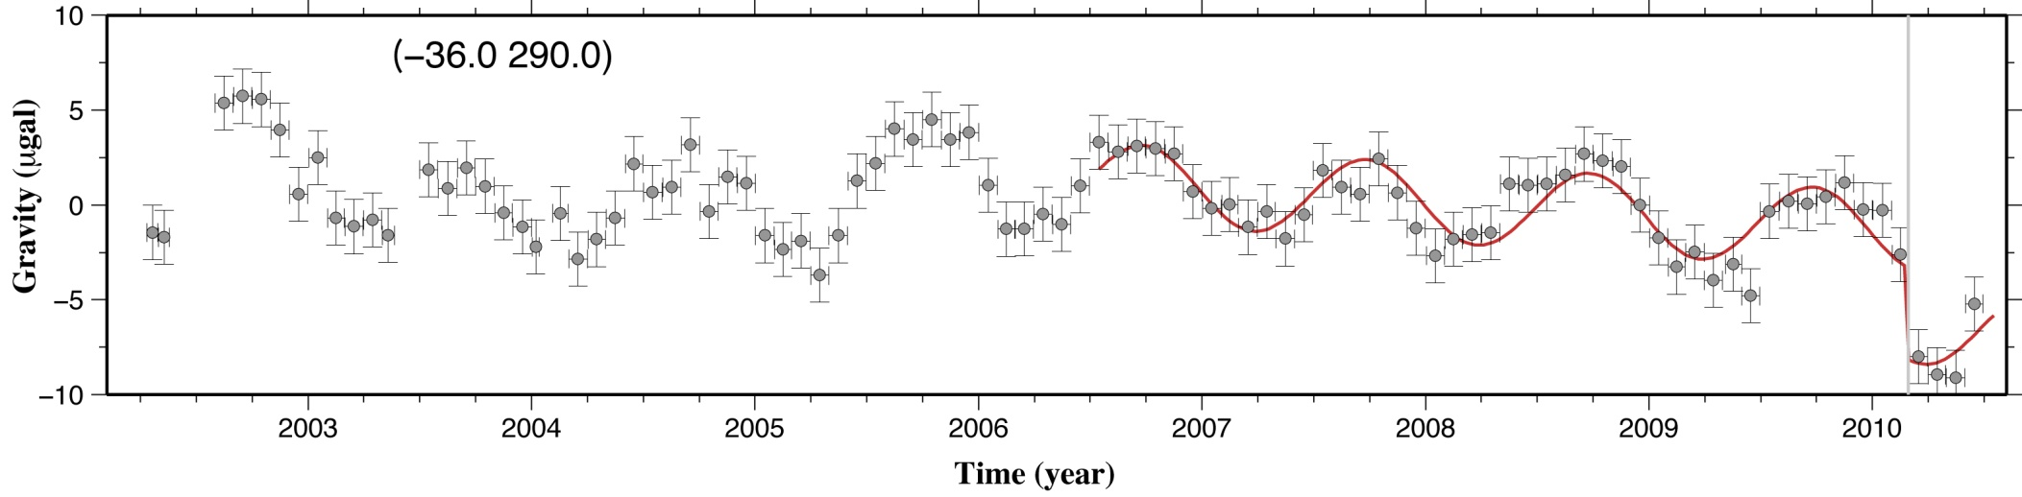
Gravity jump near the epicenter
GLACE (CSR, RL4): Replacement of C₂₀, P3M15 de-striping filter, and 300 km fan filter

Slide 11
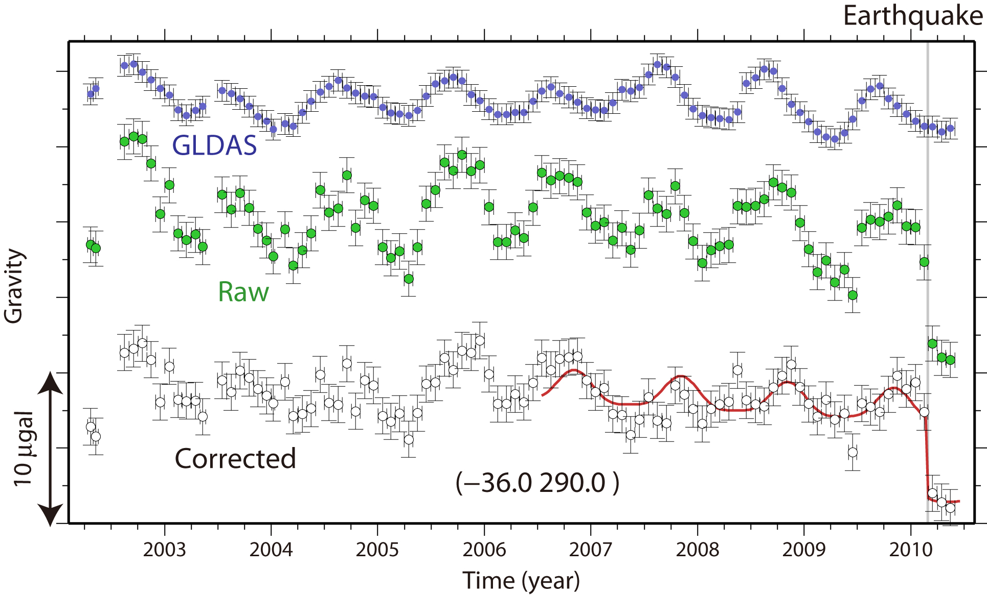
Removal of hydrological signals : GLDAS
-4.4 ± 0.8 μgal
GLDAS: 300 km Fan filter

Slide 12
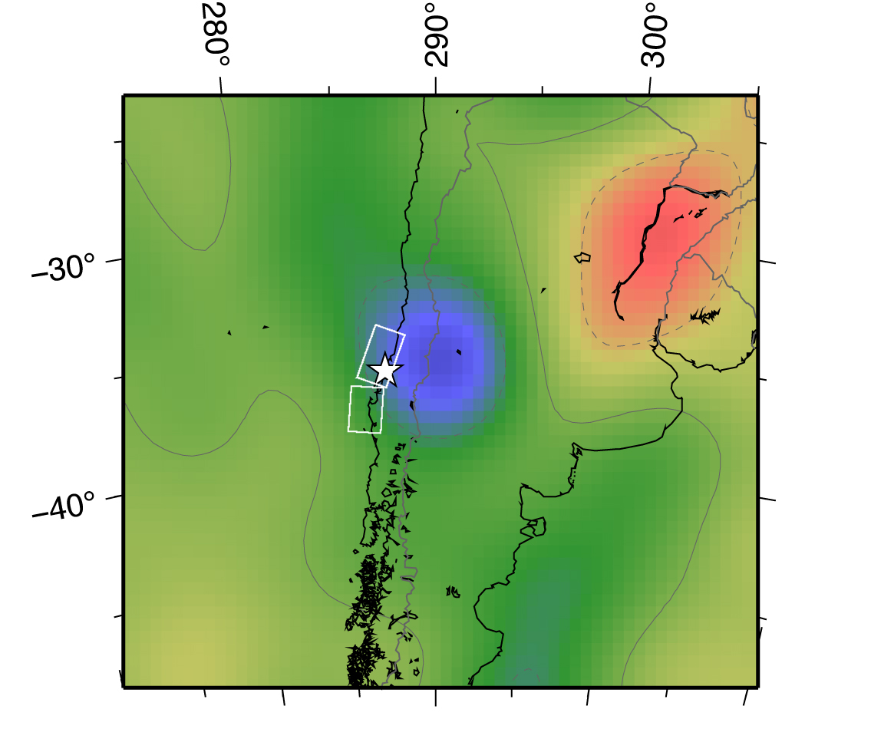
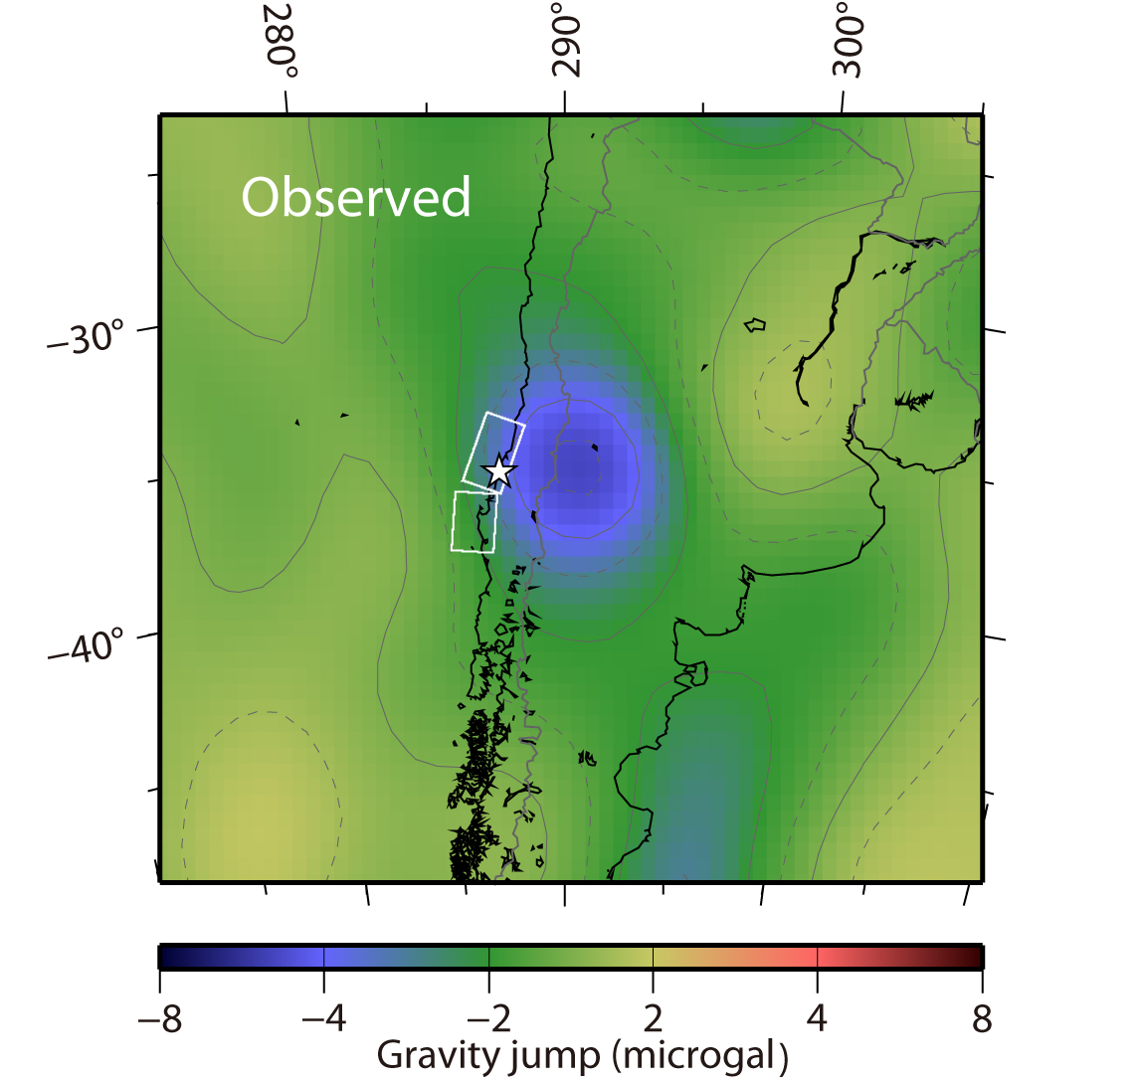
Mapping the gravity jump : removing hydrological noises
Observed
(raw)
(GLDAS corrected)
Hydrological noise
~5 microgal gravity decraese

Slide 13
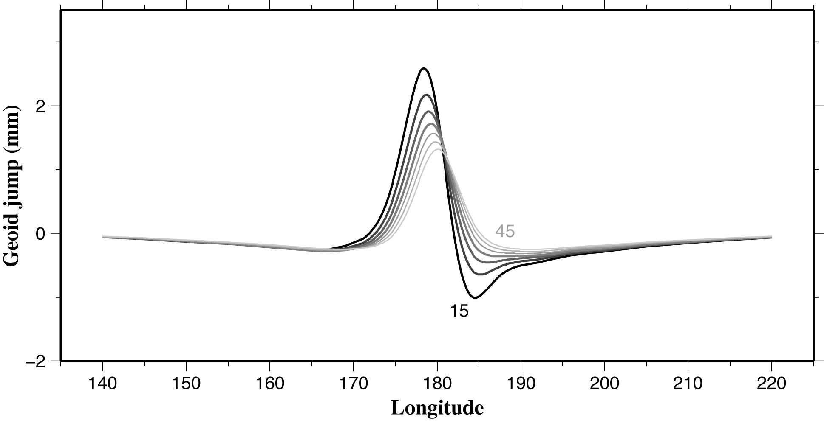
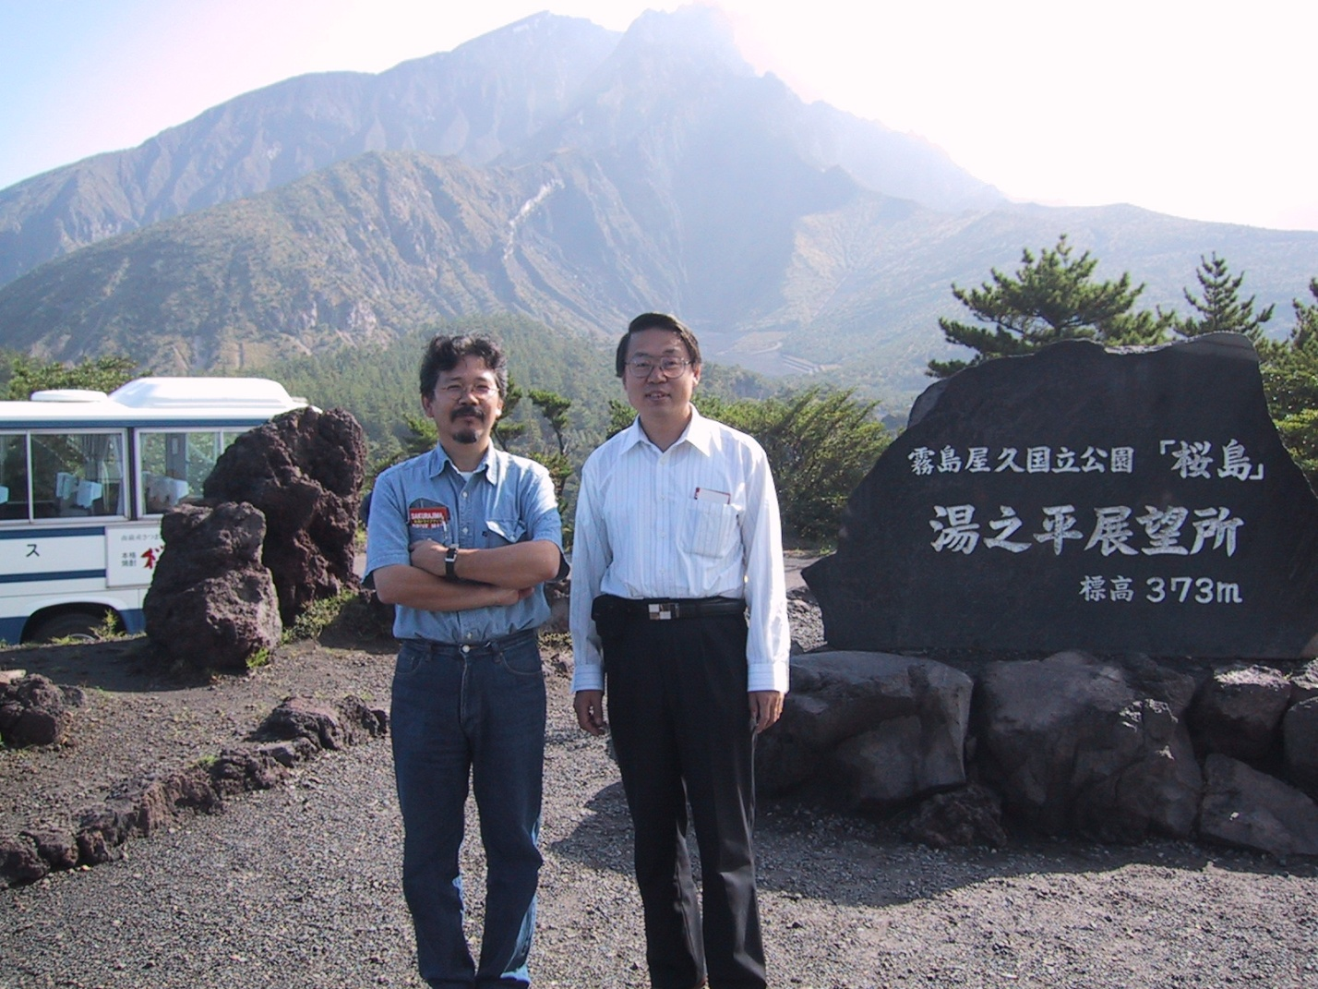
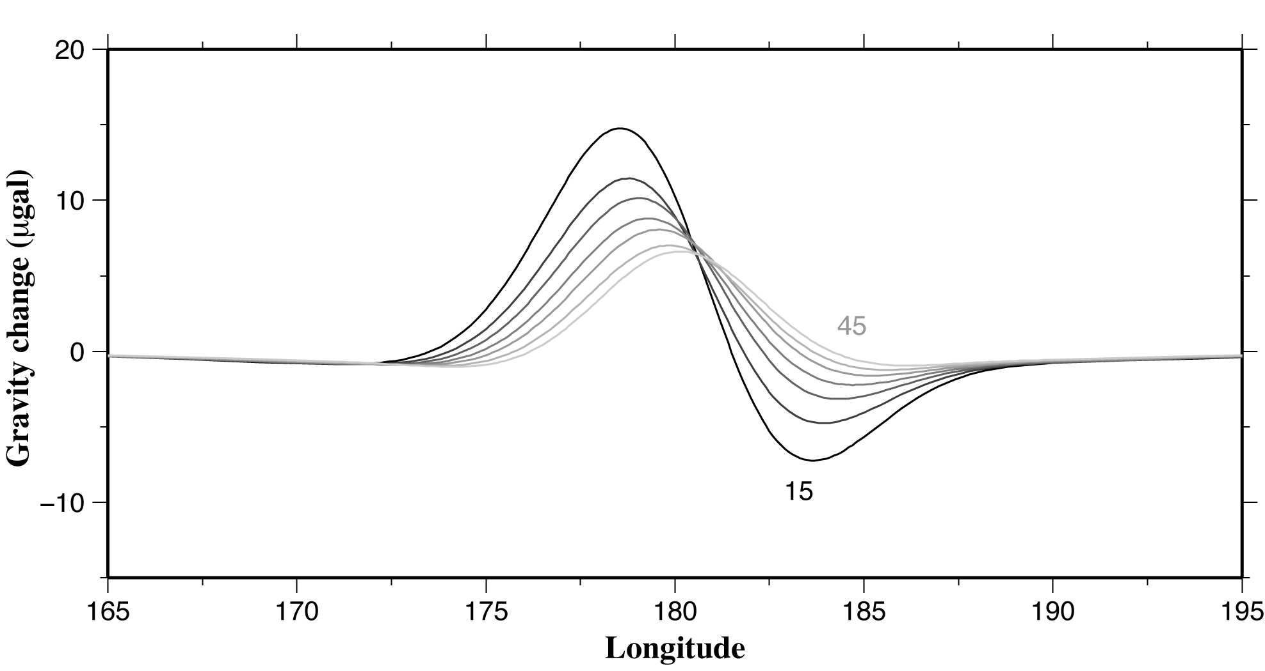
Geoid height/gravity changes due to reverse faulting at (0N, 180E)
(300 km Gaussian-filtered)
Fault depth: 5-40 km , Length: 300 km
Dislocation : 10 meter
Software after, Sun, W, S. Okubo, G. Fu, A. Araya, Geophys. J. Int., 177, 813-833, 2009.
Dip: 15-45

Slide 14
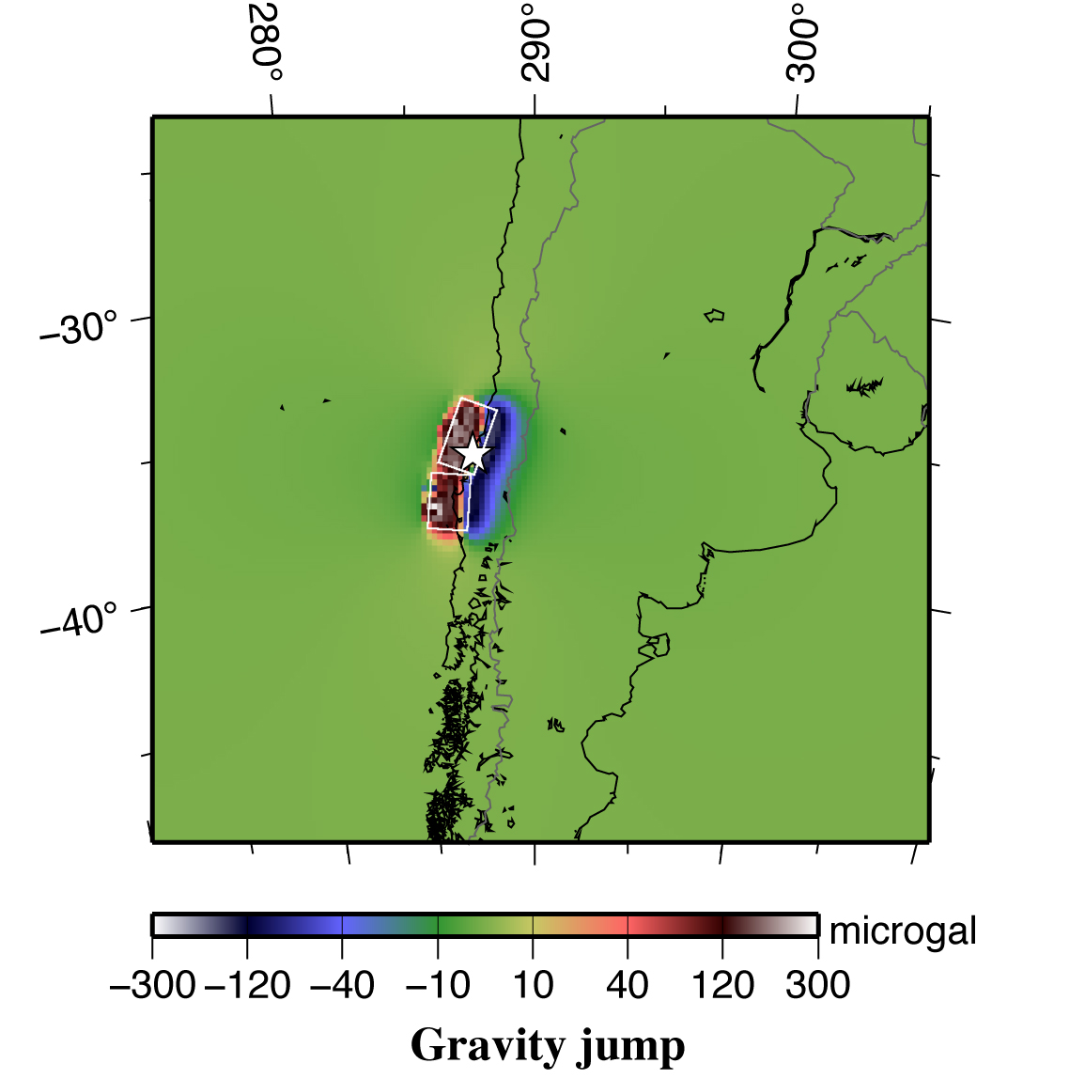
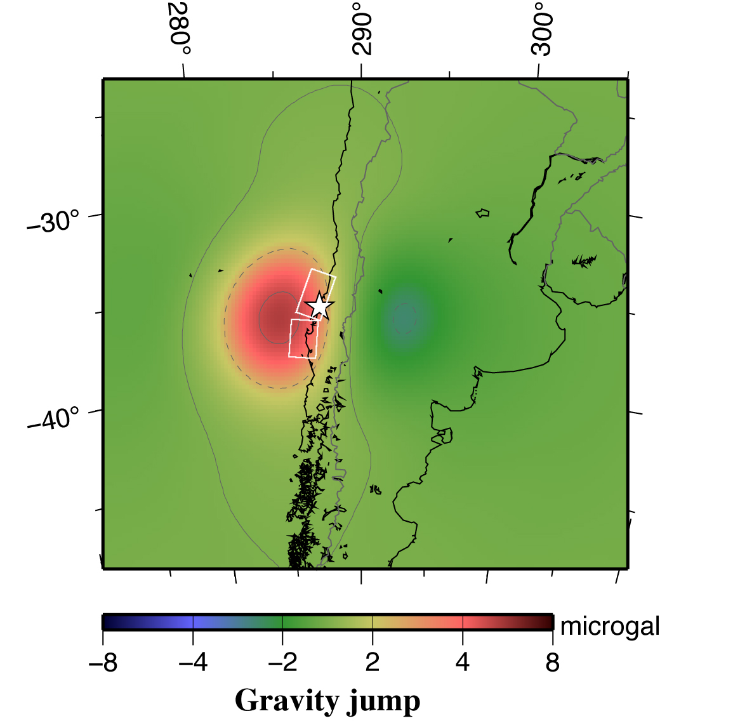
Calculate the gravity jump: program by Sun et al. [2009]
Without correction
Inconsistent with obs.
300 km filtered

Slide 15
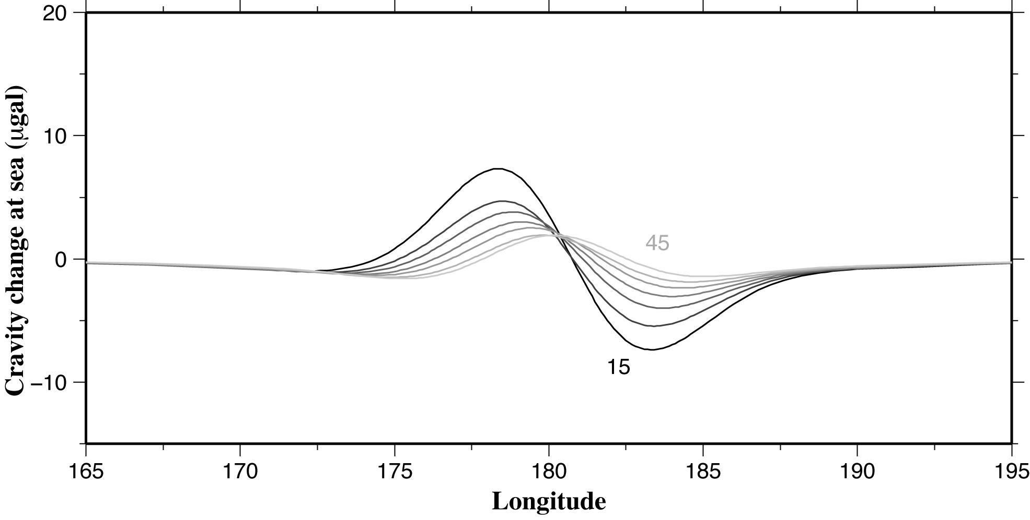
Sea water reduces gravity increase
by crustal uplift
Δg
Before correction
After correction
seawater
lithosphere
Uplift due to horizontal convergence

Slide 16
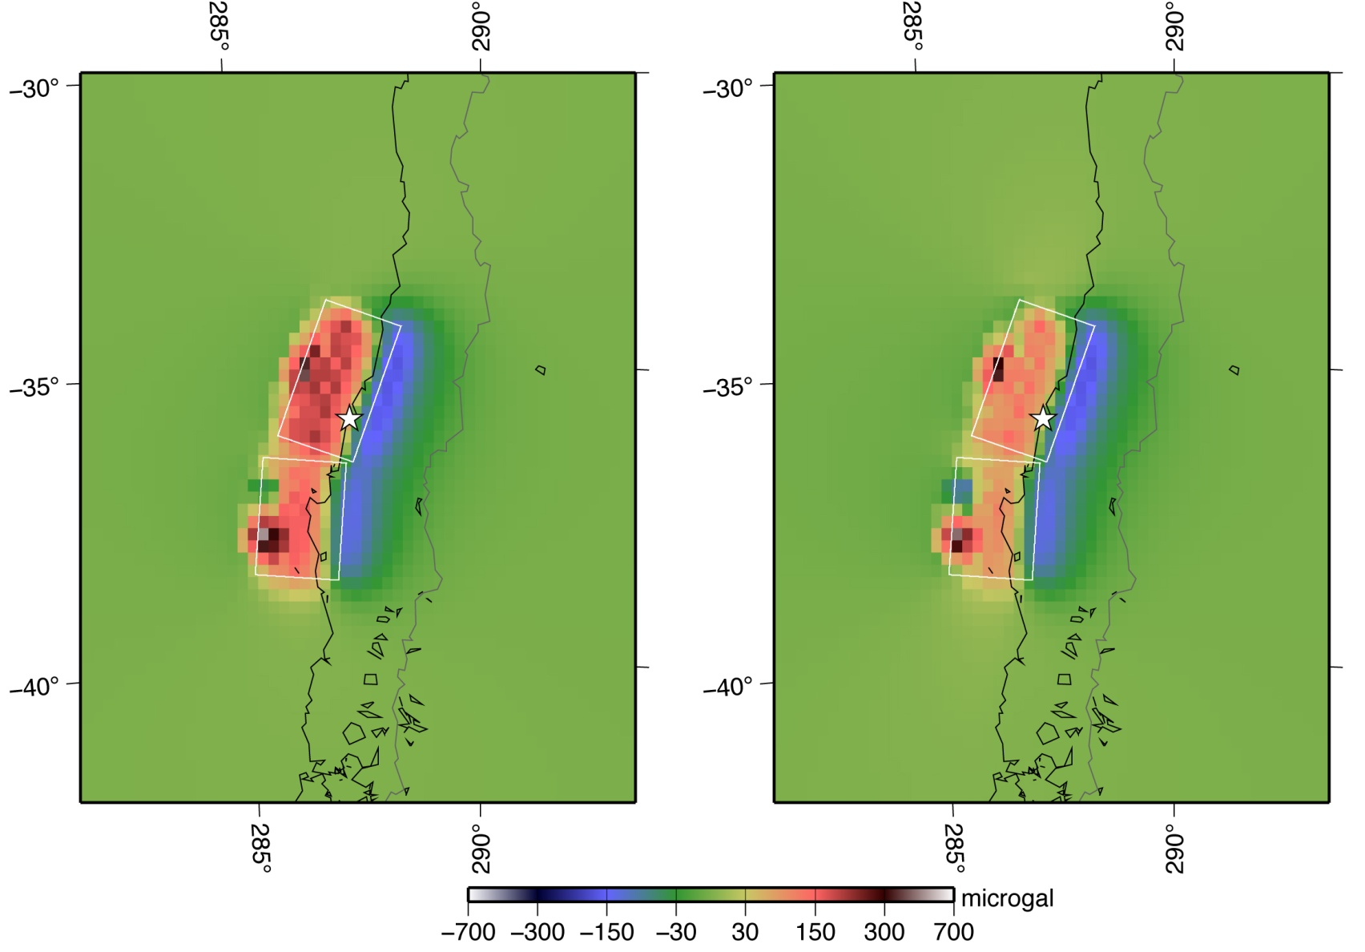
Vertical movement
Seawater corr.

Slide 17
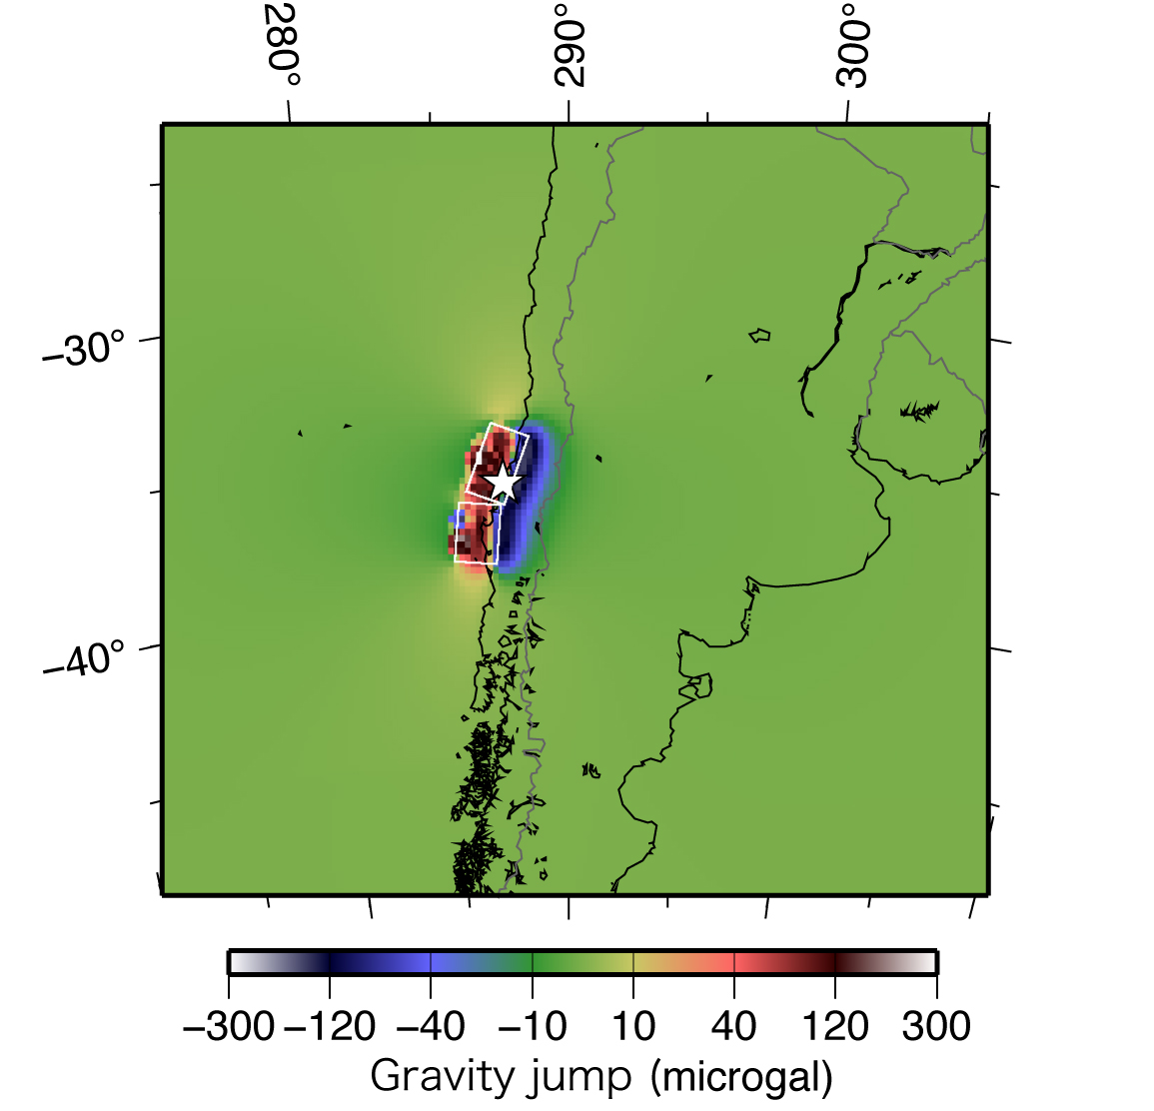
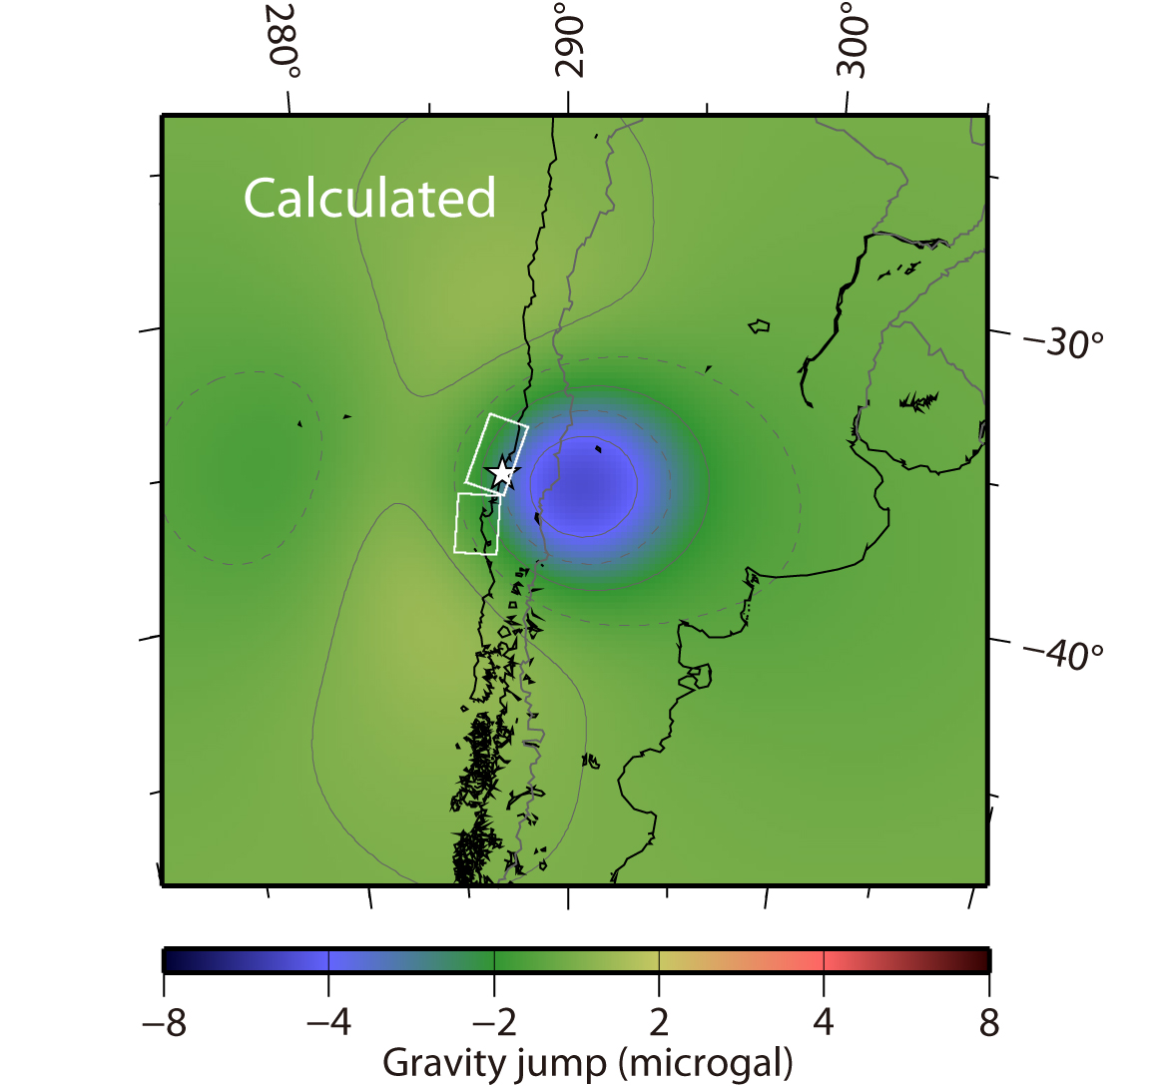
Coseismic gravity change : Calculated by Sun et al. [2009]
Consistent with obs.
Negative change of ~5 microgal
Seawater correction on

Slide 18
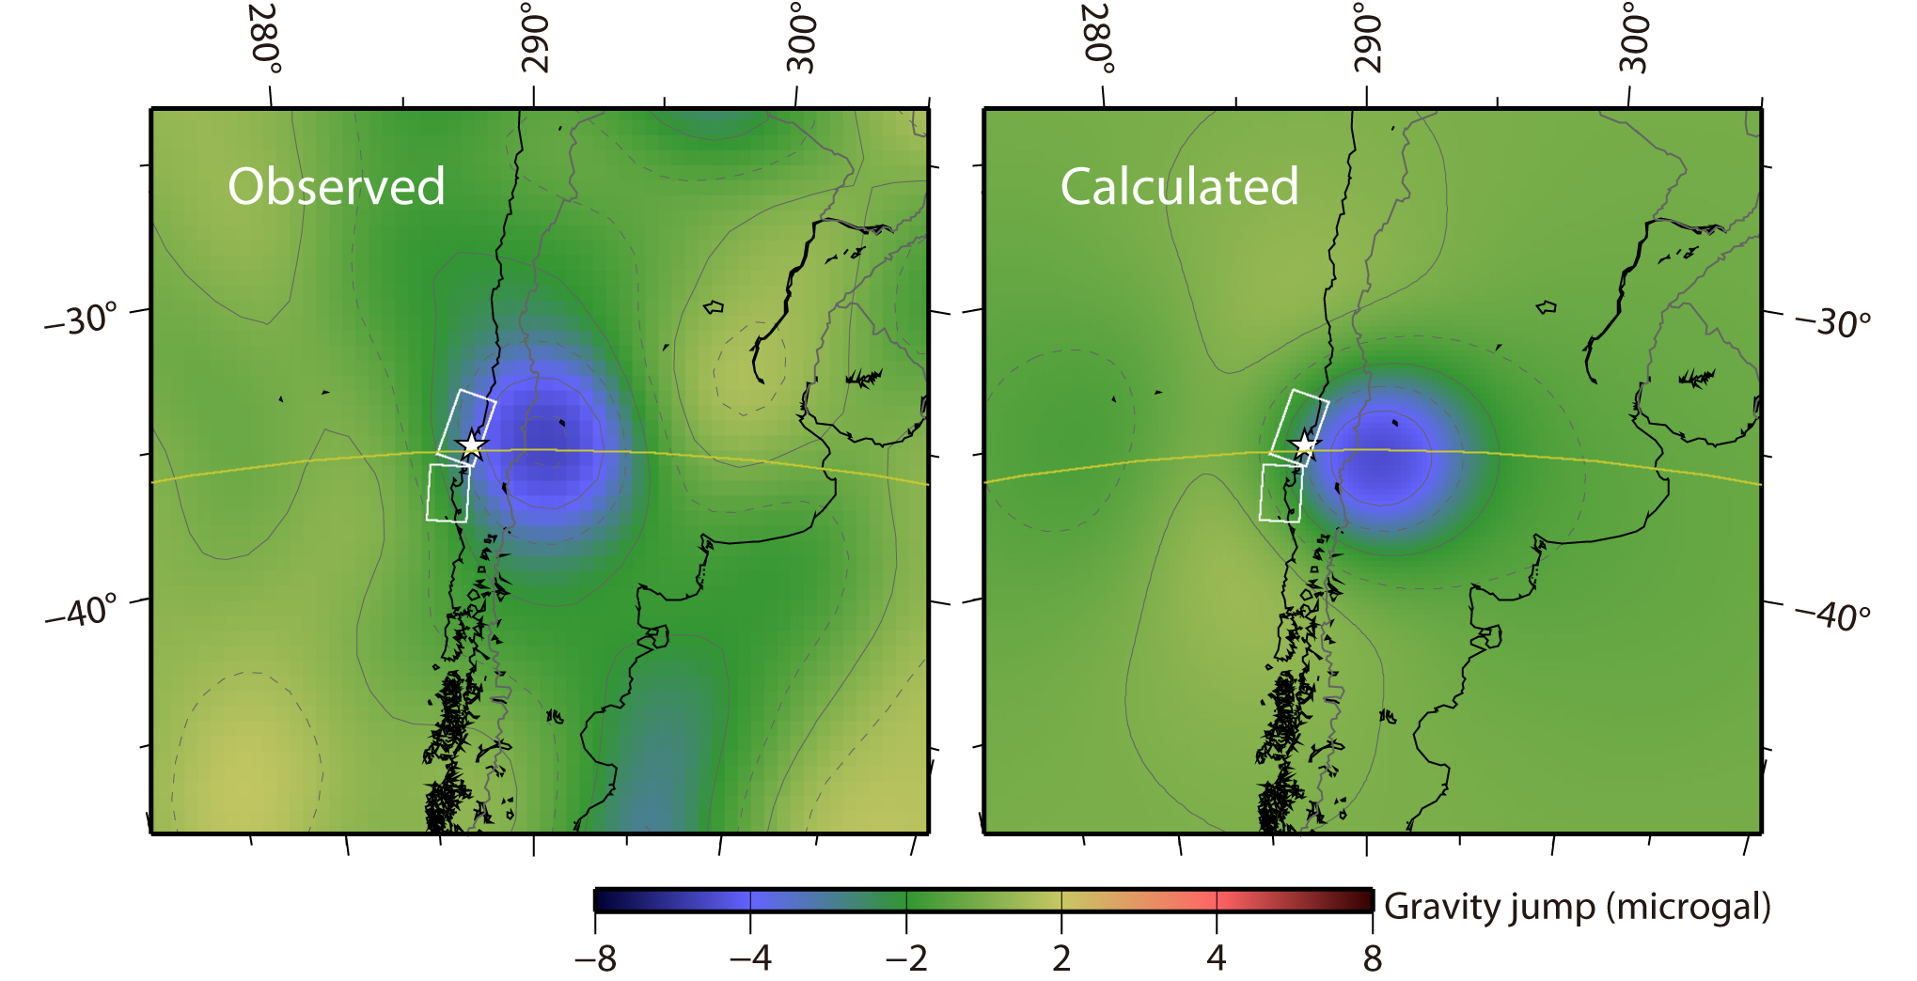
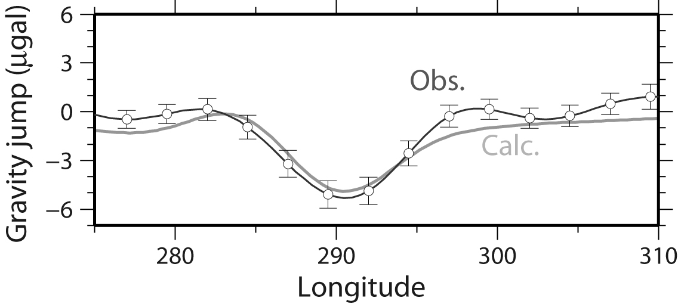
Coseismic gravity change : Obs. vs. Calc.

Slide 19
Gravity changes in past large earthquakes

Slide 20
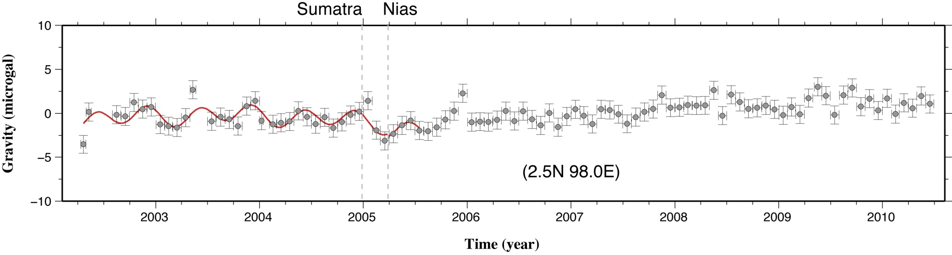
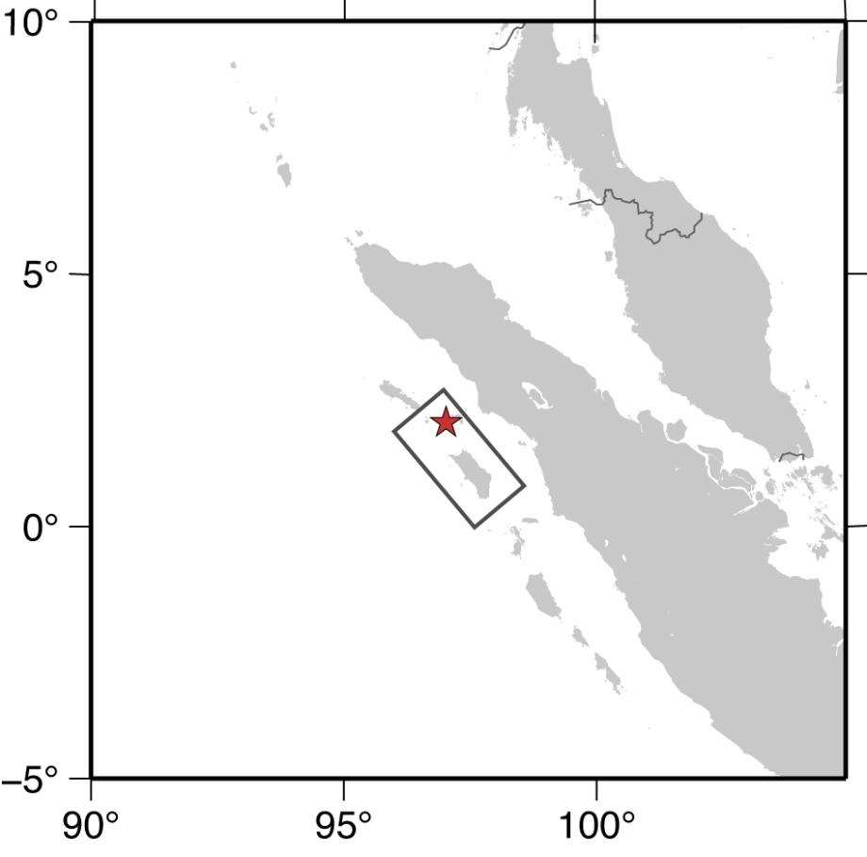
GRACE (CSR, RL4), GLDAS corrected, P3M15, 300 km Fan filter
-0.4± 0.9 μgal
Mw 8.7
2005 Mar., Nias Earthquake (Mw8.7)

Slide 21
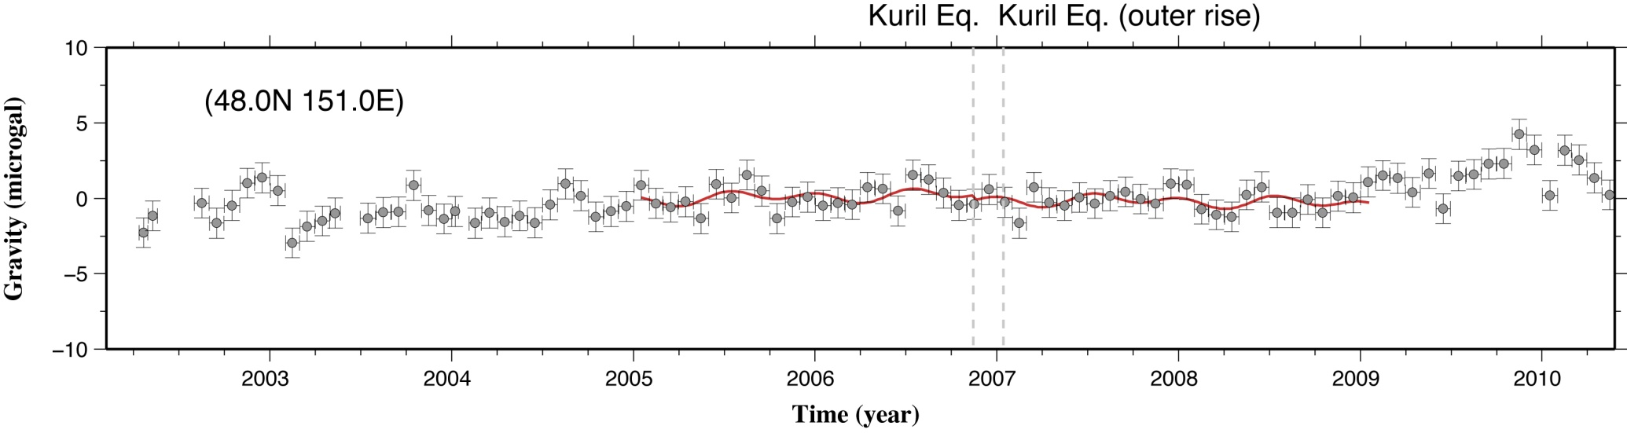
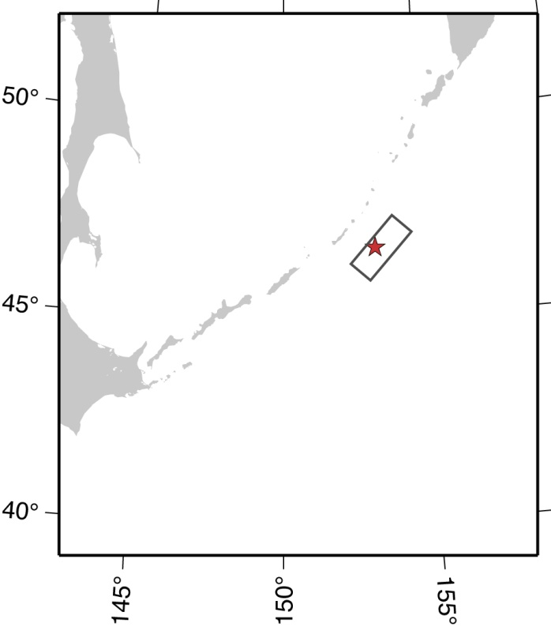
GRACE (CSR, RL4), GLDAS corrected, P3M15, 300 km Fan filter
-0.3 ± 0.5 μgal
Mw 8.2
2006 Nov., Kuril Earthquake (Mw8.2)

Slide 22
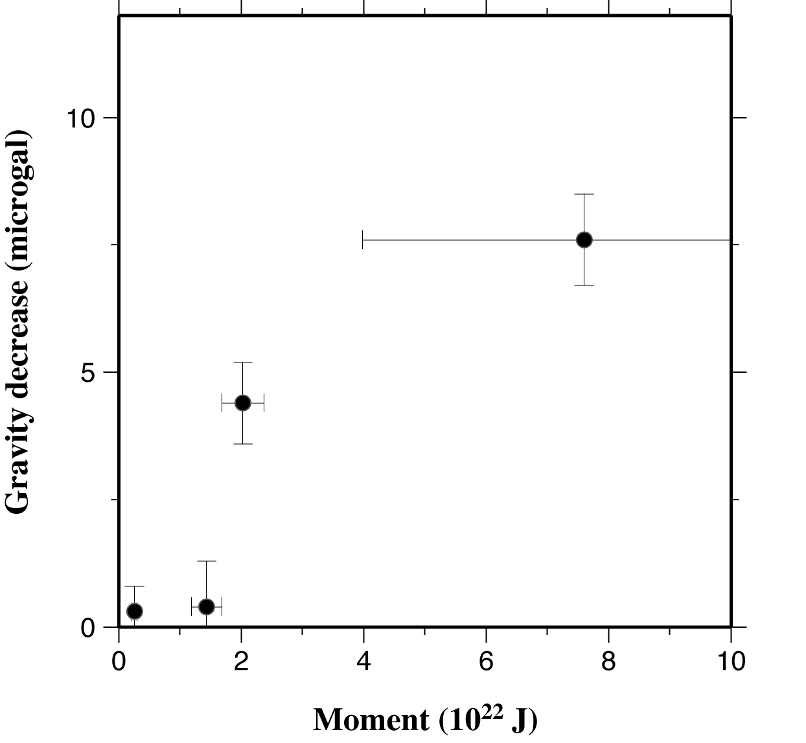
Seismic moment versus gravity change
Sumatra-Andaman
(Mw9.0-9.3)
2010 Chile (Mw8.8)
2006 Kuril Eq.
(Mw 8.1)
2005 Nias (Mw8.7)
Mw needs to be ≥ 8.8 (!?) to see it with GRACE

Slide 23
GRACE data from GRGS : not suitable for studying jumps

Slide 24
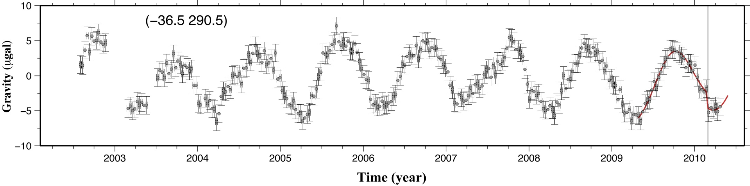
GRGS 10 days solution
-2.23 μgal
CSR RL04 monthly solution (filtered)
-4.82 μgal

Slide 25
Postseismic signal : how to separate from hydrology

Slide 26
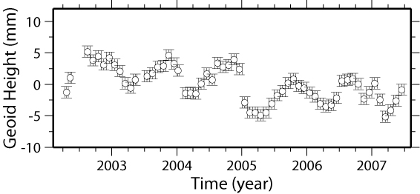

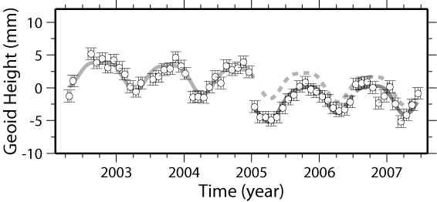
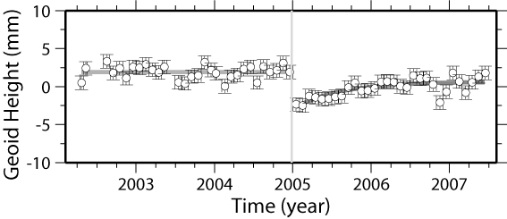
Time series of Geoid height (Ogawa & Heki, 2007)
(N7.0, E96.5)
Coseismic jump
Postseismic change
The only postseismic gravity change observed with GRACE
1. Diffusion of supercritical water at depth (Ogawa & Heki, 2007)
2. Burgers rheology of upper mantle (Panet et al., 2007)
3. Afterslip (Hasegawa et al., submitted)
We need the second example !!

Slide 27
Temporary gravity increase on land
Little gravity changes in ocean
Evapotranspiration
Hydrological signals in gravity change

Slide 28
Not only seasonal, but also interannual

Slide 29
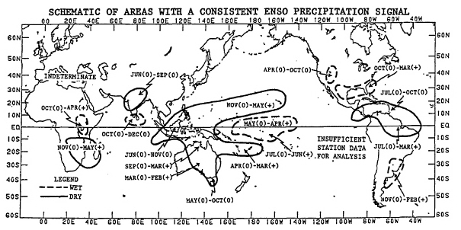
Precipitation Anomalies by ENSO
dry
wet
Ropelewski, C.F. and M.S. Halpert, Global and regional scale precipitation patterns associated with the El Niño/Southern Oscillations, Month. Weather Rev., 115, 1606-1626, 1987.

Slide 30
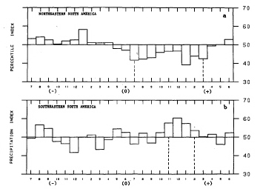
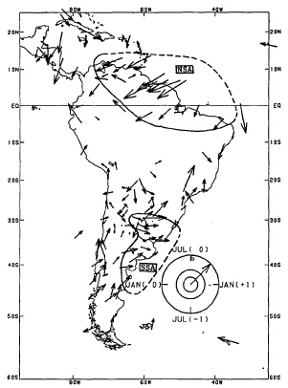
Less rain
in February
Jul
Jan
Jan(+1)
More rain
in February
Jul(-1)
Precipitation index
dry
Austral summer
wet
Precipitation Anomalies by ENSO:
South America

Slide 31
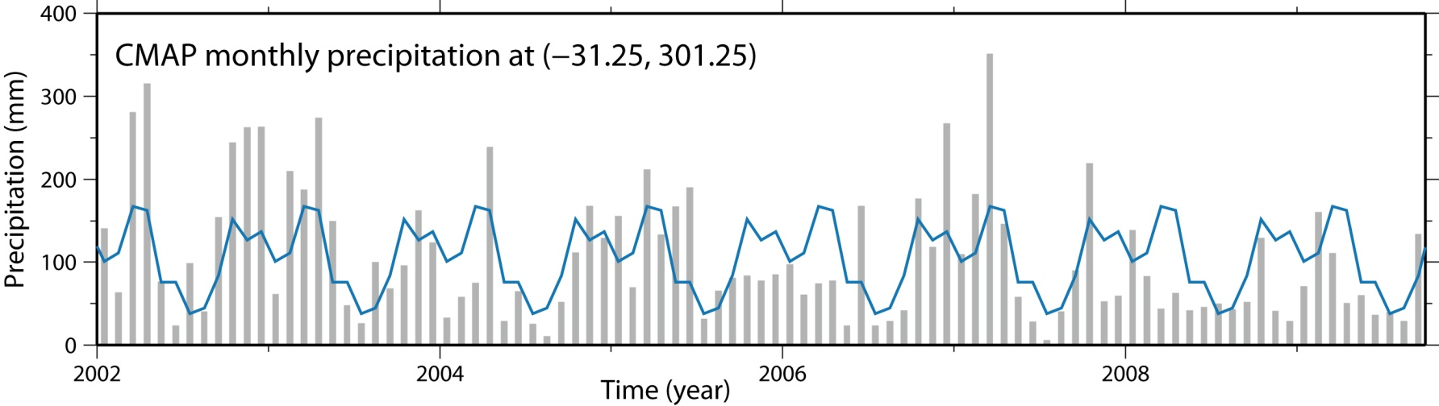
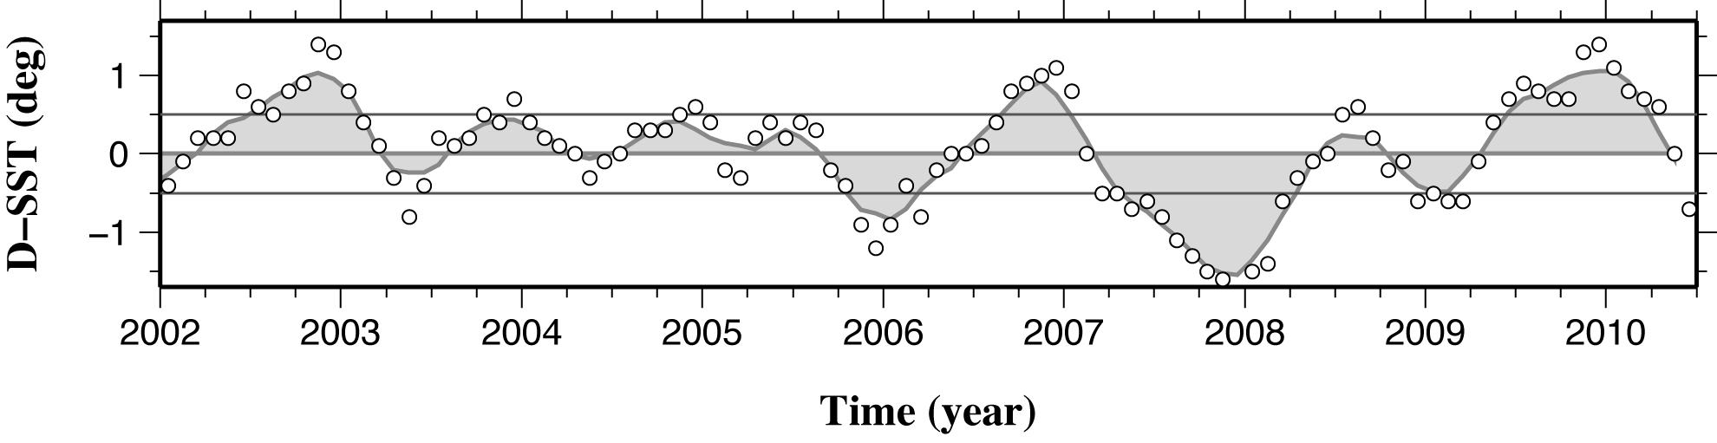
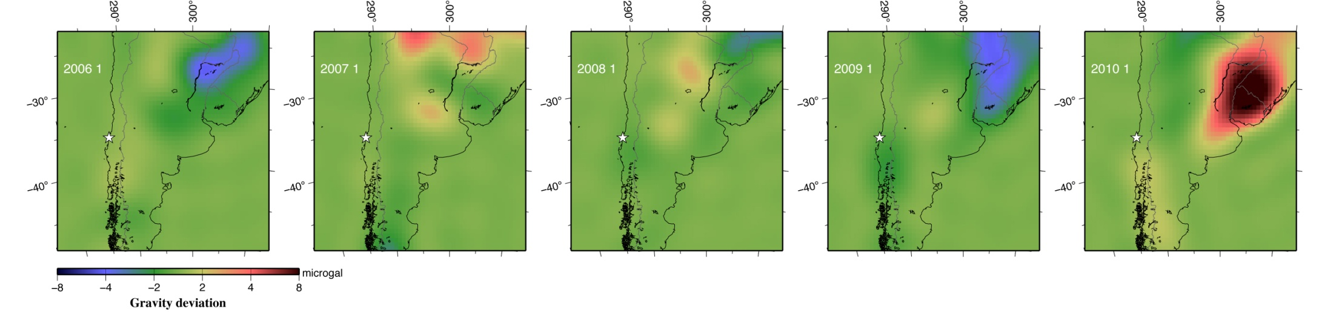
Wet
Dry
Precipitation anomaly seen in GLDAS
(deviation from average seasonal change)
ENSO index (NINO.3 SST anomaly)
El Niňo
La Niňa
GLDAS (converted to gravity)

Slide 32
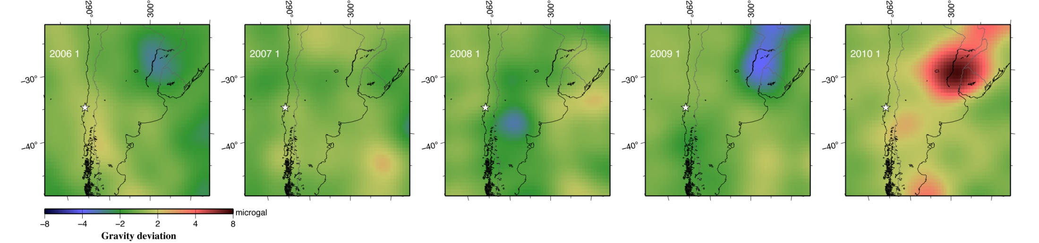
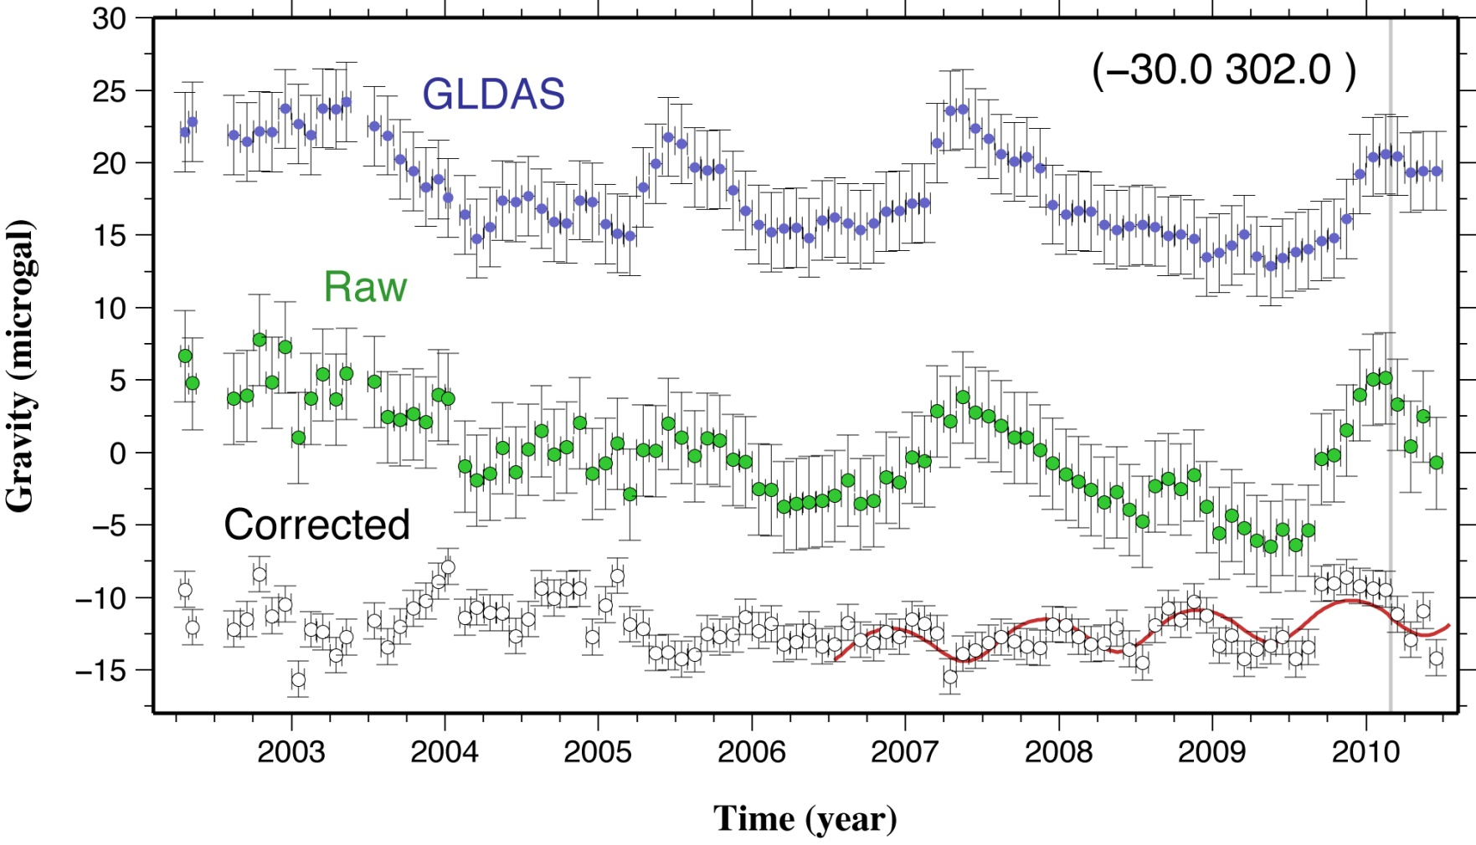
Gravity change in southern South America
1. No regular seasonal changes
2. Large interannual variations
3. Difficult to model
GRACE
GLDAS (converted to gravity)

Slide 33
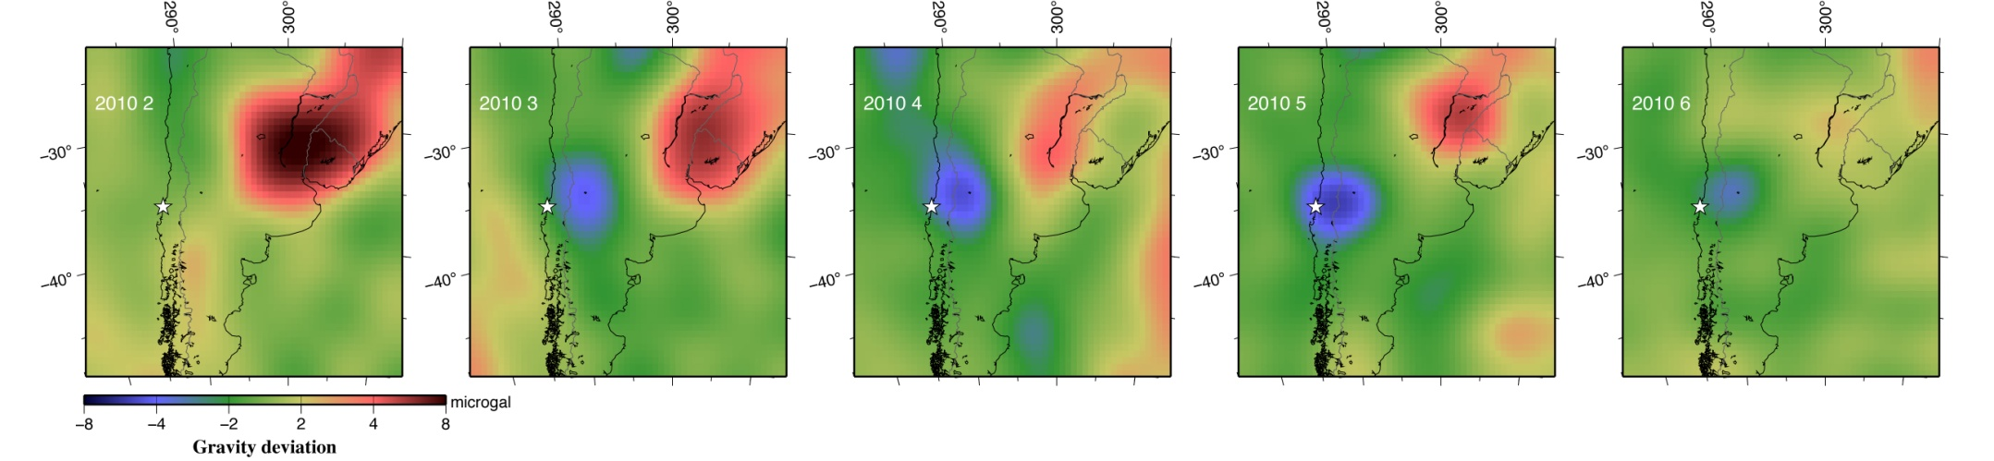
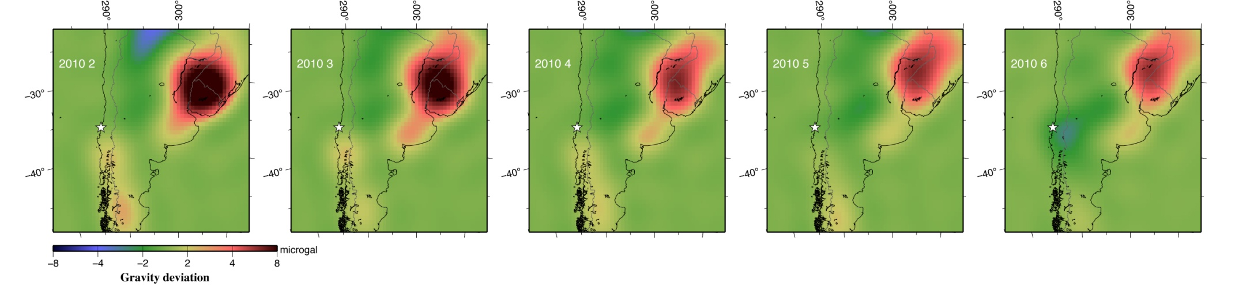
Earthquake
Postseismic change ?
GRACE (GLDAS not corrected, 300km FF, P3M15)
Gravity 2010 Jan-May GRACE vs GLDAS
GLDAS (converted to gravity, 100km FF, no de-striping)

Slide 34
Postseismic gravity change: wait and see
Polar motion : any detectable changes?

Slide 35
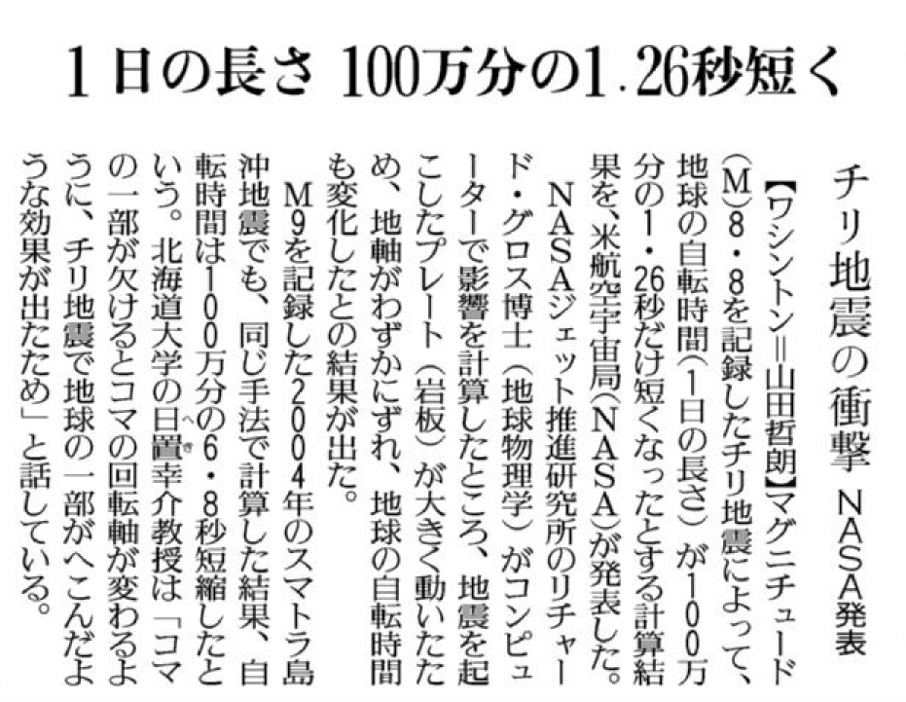
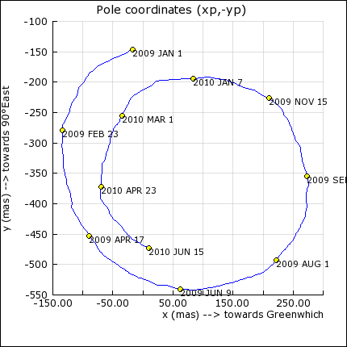
News article after
the 2010 Chile Eq.
(Yomiuri Newspaper)
Pole shift ~3 mas
Polar motion from OP (Obs. Paris)

Slide 36
Dent in Chile
Shift of pole (TPW) due to mass redistribution

Slide 37
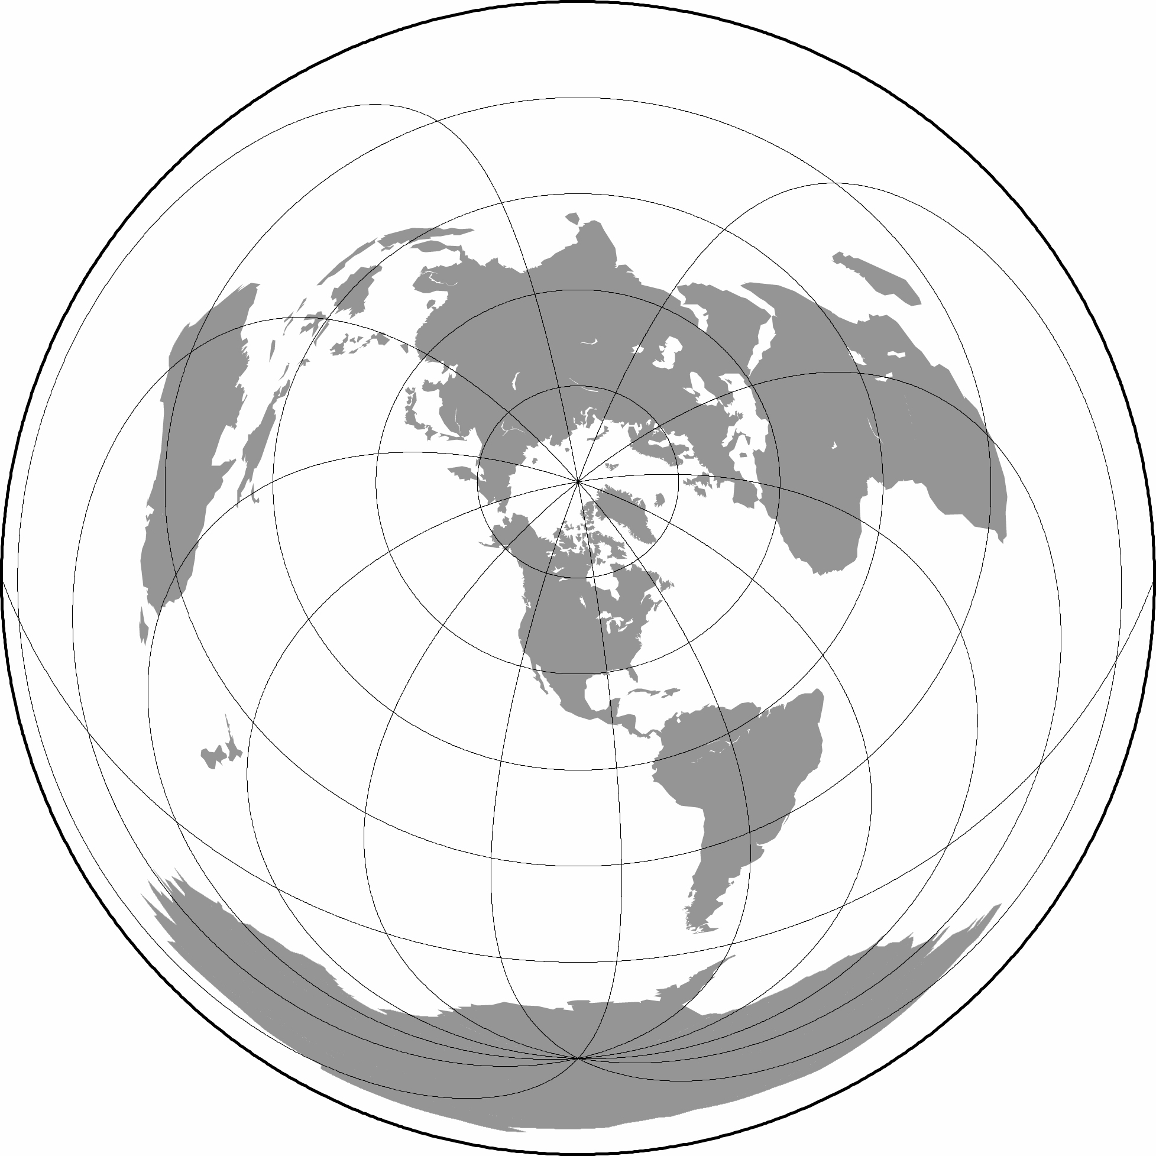
Calculated pole shift
2004 Sumatra
22.6 mas
(115E)
~3 mas
by 2010 Chile
0.8 mas
(145E)
7.5 mas
(198E)
1964 Alaska
2010 Chile
1960 Chile
After Chao & Gross (1987, 2005), Gross (2010)

Slide 38

A discouraging commentary from Observatoire de Paris
March 2010 : The Chile Earthquake of February 27th, 2010 of magnitude 8.8 has caused no DETECTABLE effect on the rotation pole and rotation rate. Independently of Earthquake, rotation pole moves of some mm up to several cm per day because of continuous atmospheric, oceanic and hydrologic mass transport. Till now the effect of Earthquake remains a theoretical matter. According to the seismic models, the recent Chile event will have the effect of disturbing the rotation pole by 8 cm in some months, small amount in comparison with the path a few meters it will achieve during this period. By handling atmospheric, oceanic and hydrologic data, this path will be modeled with a mean error of 50 cm, so that the tiny seismic effect will probably remain indiscernible.
・・・・
Alone a mega-seism, such that of Chile in 1960, could cause a visible effect with the modern geodetic techniques.

Slide 39
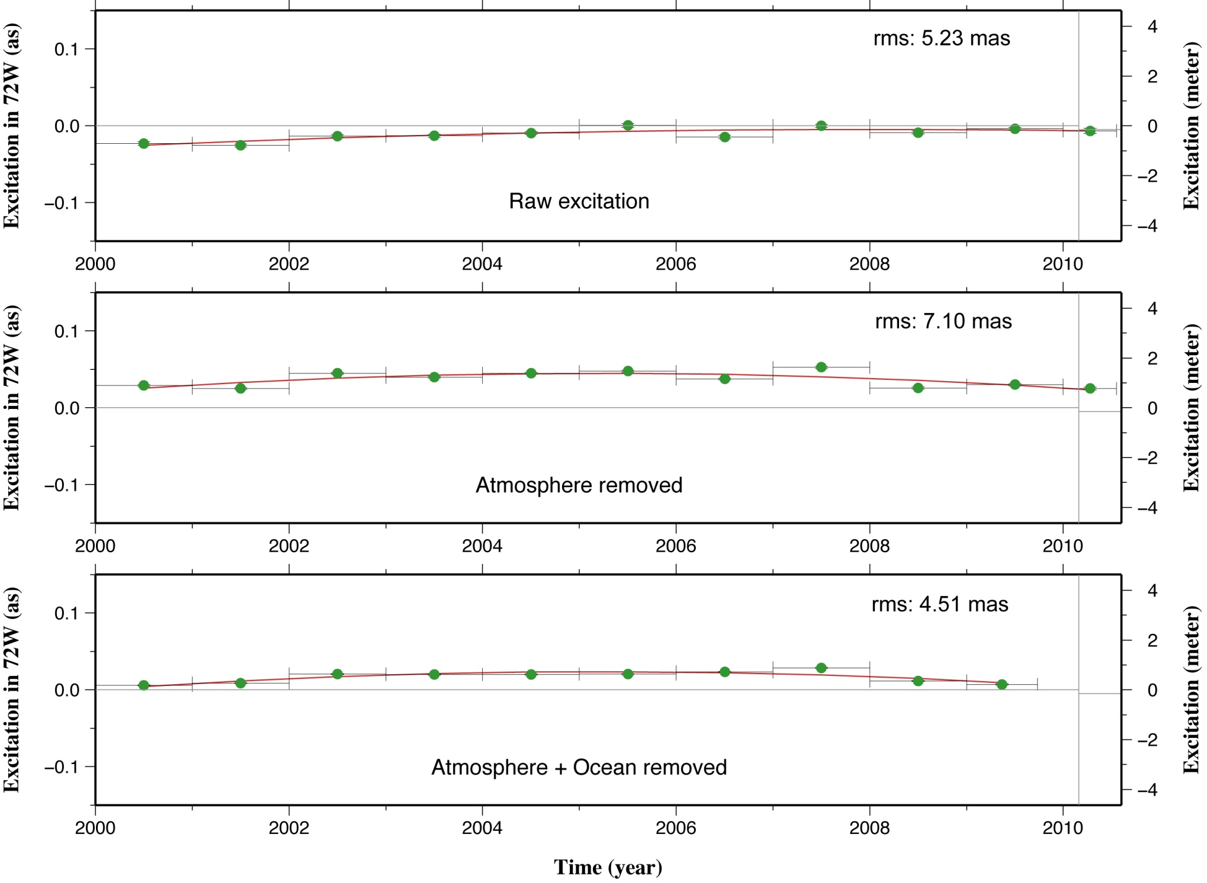

Polar motion excitation data from Observatoire de Paris
Remaining factor : soil moisture, snow, ice
3 mas jump

Slide 40
Polar motion : Let’s wait and see

Slide 41

Thank you for your attention
Trillium in the Hokkaido Univ. Campus

